Slide 1

https://mmiv.no
Progress in Radiology 2018, June 14th 2018
https://www.uib.no/en/jsrs2018
Machine Learning for Precision Imaging
Prof. Arvid Lundervold BSc, MD, PhD
Department of Biomedicine, University of Bergen &
Mohn Medical Imaging and Visualization Centre, Department of Radiology, Haukeland University Hospital, Bergen, Norway
http://github.com/arvidl/computational-medicine

Slide 2
ABSTRACT
Machine learning (ML) aims to construct “programs or systems that builds and trains predictive models from input data, and uses the learned models to make useful predictions from new (previously unseen) data, drawn from the same distribution as the one used to train the models”. In this talk I'll put ML in the context of computational imaging and precision medicine (“integrating detailed information from multiple sources in a holistic manner”), focusing on morphological and functional MRI. Examples from previous and ongoing research in the ML-project at the MMIV Centre will be given. E.g. automated tissue classification in multispectral brain MRI, fast segmentation of brain and kidney using deep convolutional neural networks and transfer learning (joint with Alexander S. Lundervold), coregistration of histology and multiparamtric MRI for the use of ML in prostate cancer, and application of ML in predicting irritable bowel syndrome (IBS) from multimodal brain MRI, addressing the brain-gut interaction in functional gastrointestinal disorders. Finally, I'll present some thoughts regarding future opportunities and challenges of (bio)medical imaging and machine learning for precision medicine.
Arvid Lundervold, BSc, MD, PhD is a professor in medical information technology and physiology at the University of Bergen, Norway. He is leading the Neuroinformatics and Image Analysis Laboratory in The Neural Networks Research Group (https://www.uib.no/en/rg/neuronet), Department of Biomedicine, and is PI (“Computational medical imaging and machine learning - methods, infrastructure and applications”) at the Mohn Medical Imaging and Visualization Centre (https://mmiv.no), Department of Radiology, Haukeland University Hospital. His current research interests are in the fields of medical image processing and pattern recognition; multimodal and functional imaging (in brain, kidney and in oncology); image segmentation; image registration; longitudinal imaging; imaging-based biomarkers; mathematical and statistical modeling including machine learning. Contact information at https://www.uib.no/en/persons/Arvid.Lundervold.

Slide 3
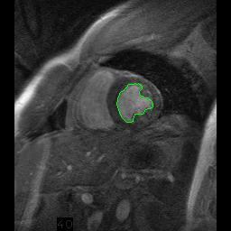
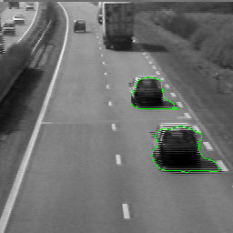
Computational imaging

Slide 4
Machine Learning
A program or system that builds (trains) a predictive model from input data.
The system uses the learned model to make useful predictions from new (never-before-seen) data drawn from the same distribution as the one used to train the model.
Prediction at the patient level ,…, voxel level
https://developers.google.com/machine-learning/glossary

Slide 5

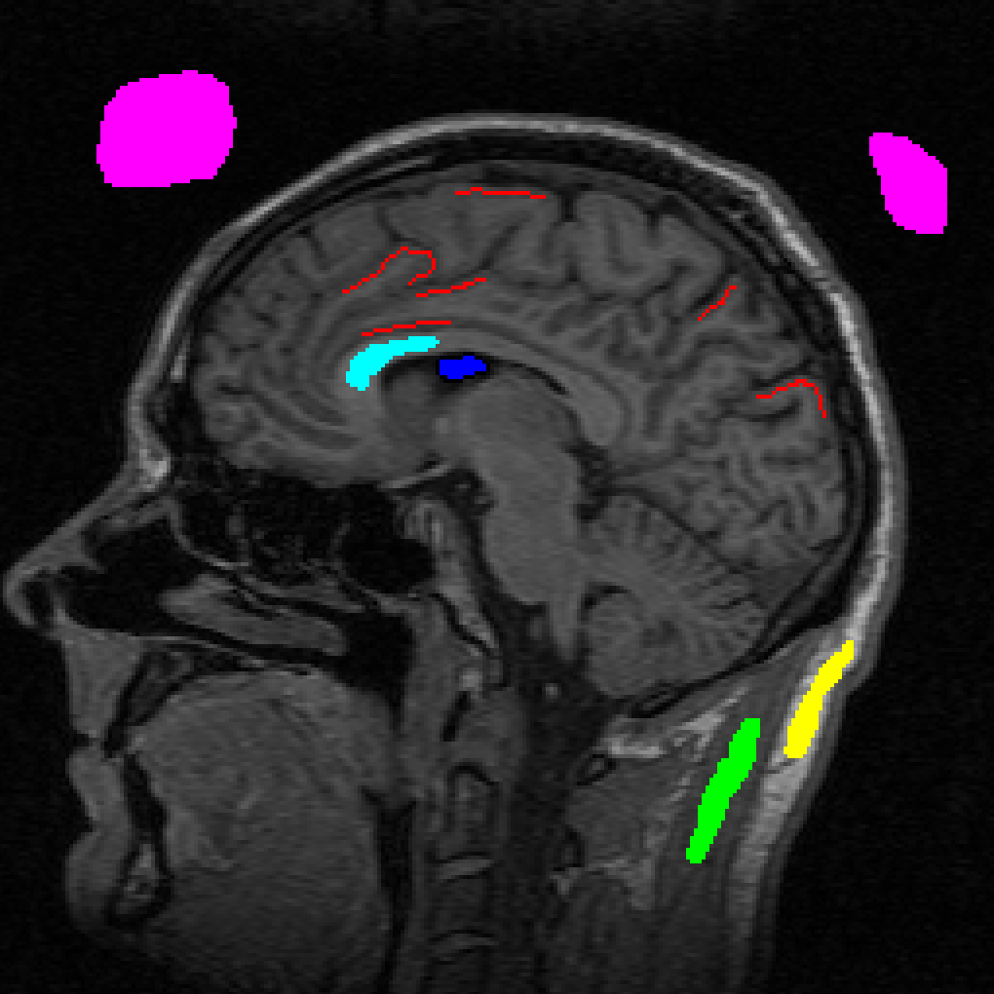
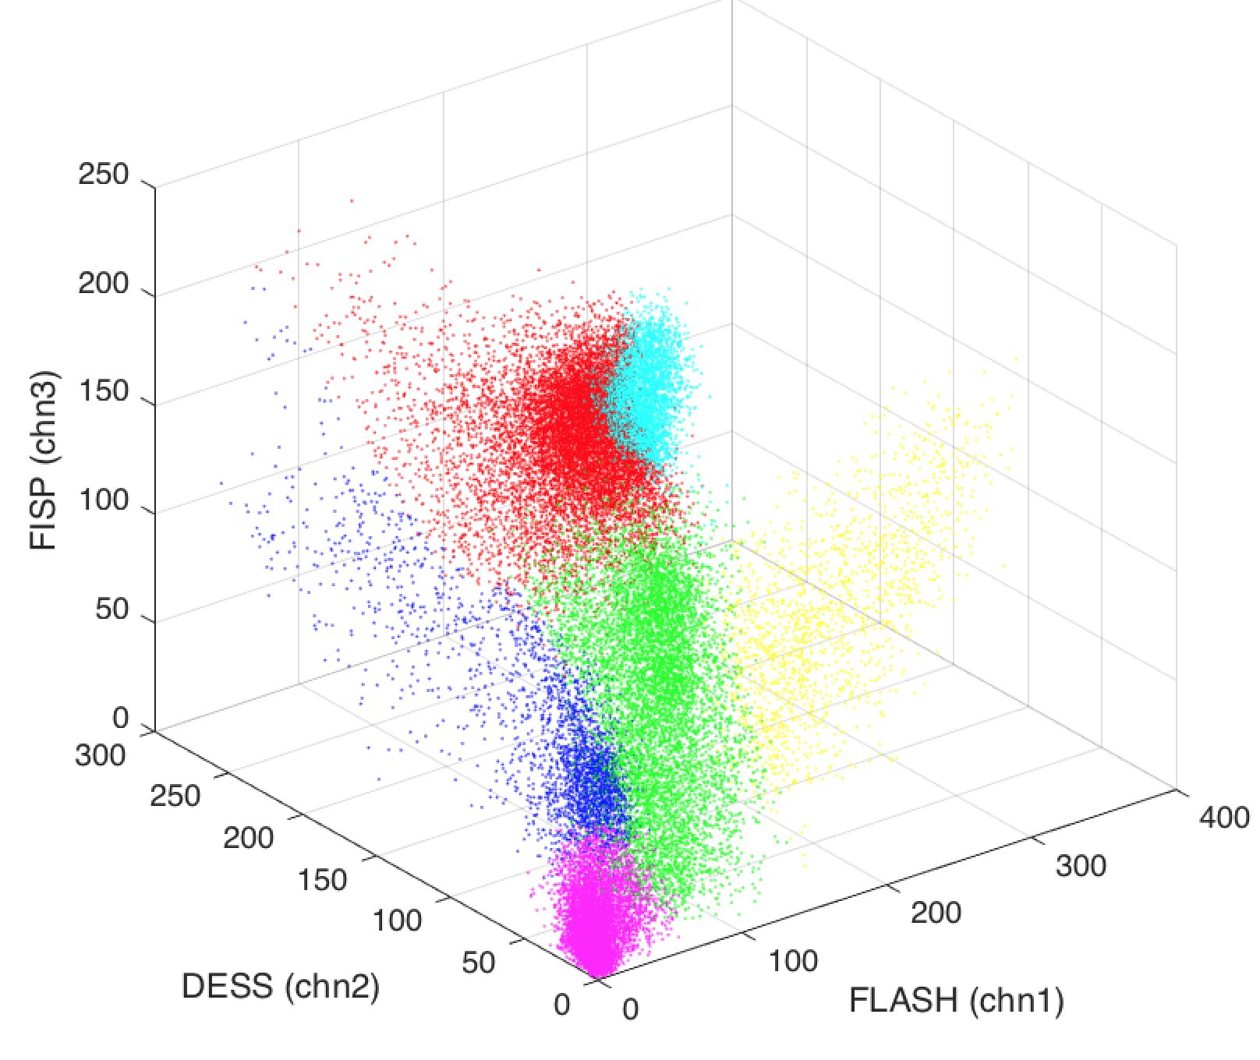
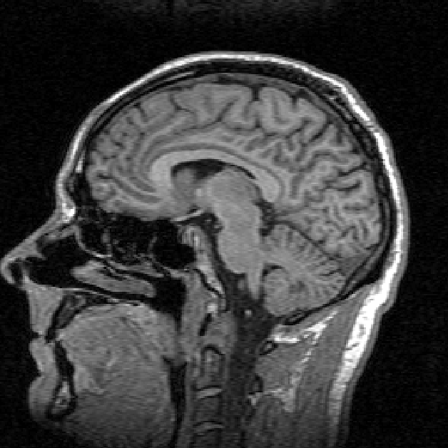
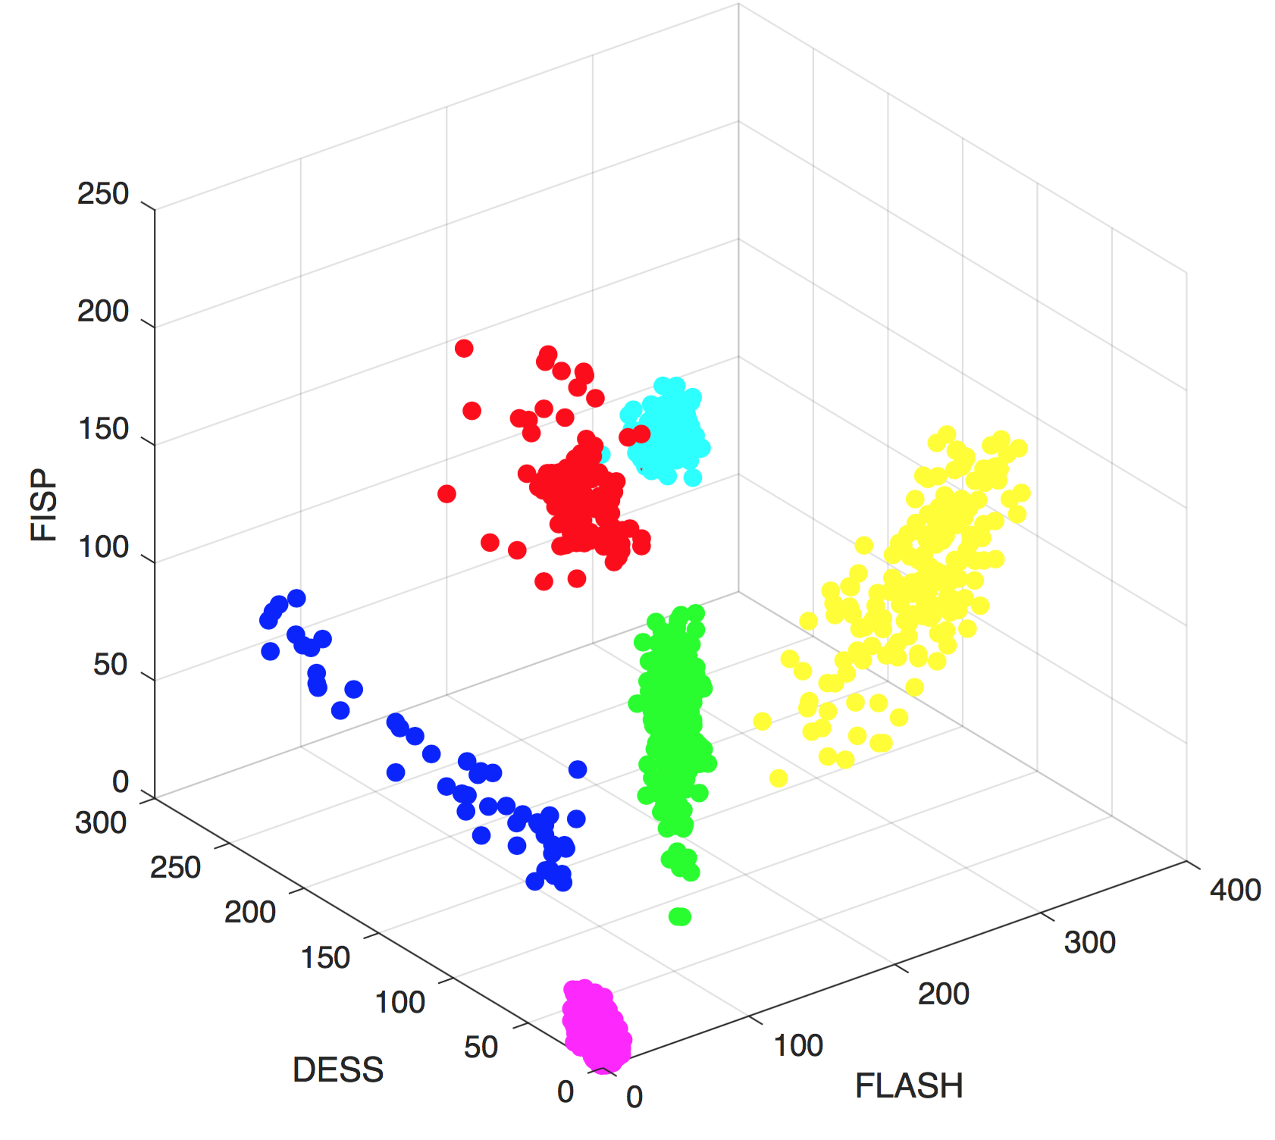
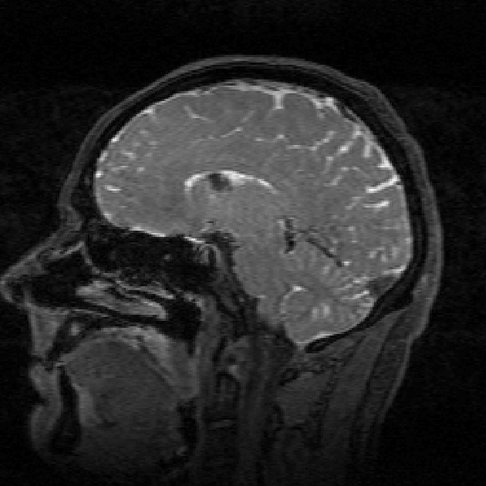
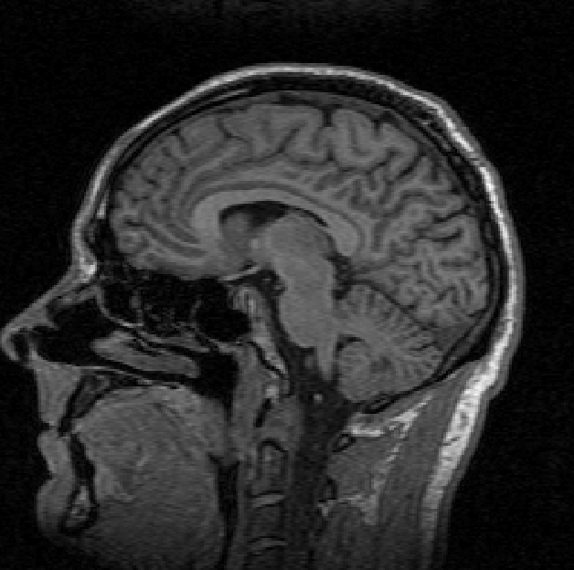
Automated tissue classification
Air
Grey matter
White matter
CSF
Muscle
Manual labeling of data
Fat
z
R³
⇧
FISP
Supervised kNN
tissue classification
y
x
DESS
FLASH

Slide 6
Precision Medicine
Integrating detailed patient information from multiple sources in a holistic manner
Biomedical imaging and imaging-guided interventions, which provide multiparametric morphologic and functional information and enable focused, minimally invasive treatments, are key elements in the infrastructure needed for PM
C.J. Herold et al. Radiology, April 2016

Slide 7
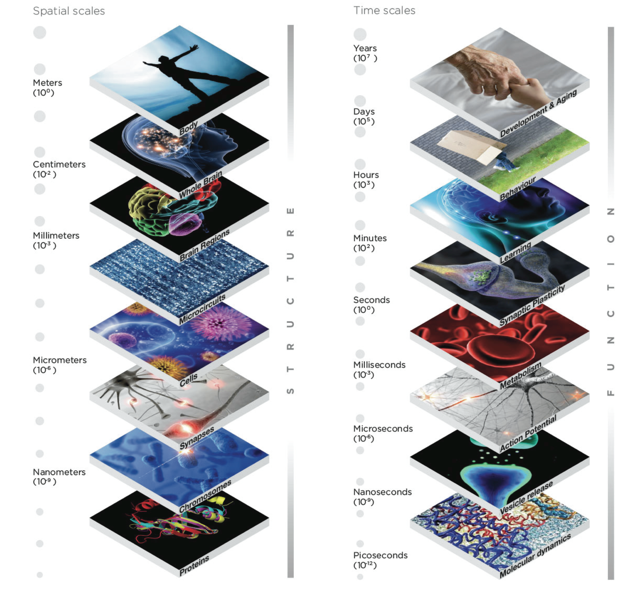
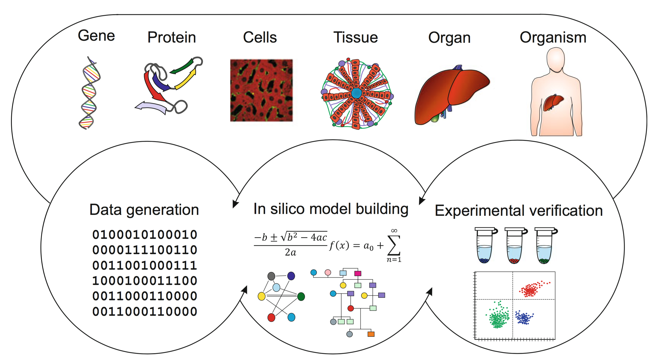
Systems medicine and computational imaging
precision medicine
MULTISCALE
Spatial scales
Time scales
S T R U C T U R E
F U N C T I O N
wet-lab
dry-lab
moist-lab
http://core-genomics.blogspot.no/2014/02/wet-lab-dry-lab-or-moist-lab.html
Ulf Schmitz, Olaf Wolkenhauer (eds) Systems Medicine, Springer, 2016
https://www.humanbrainproject.eu

Slide 8
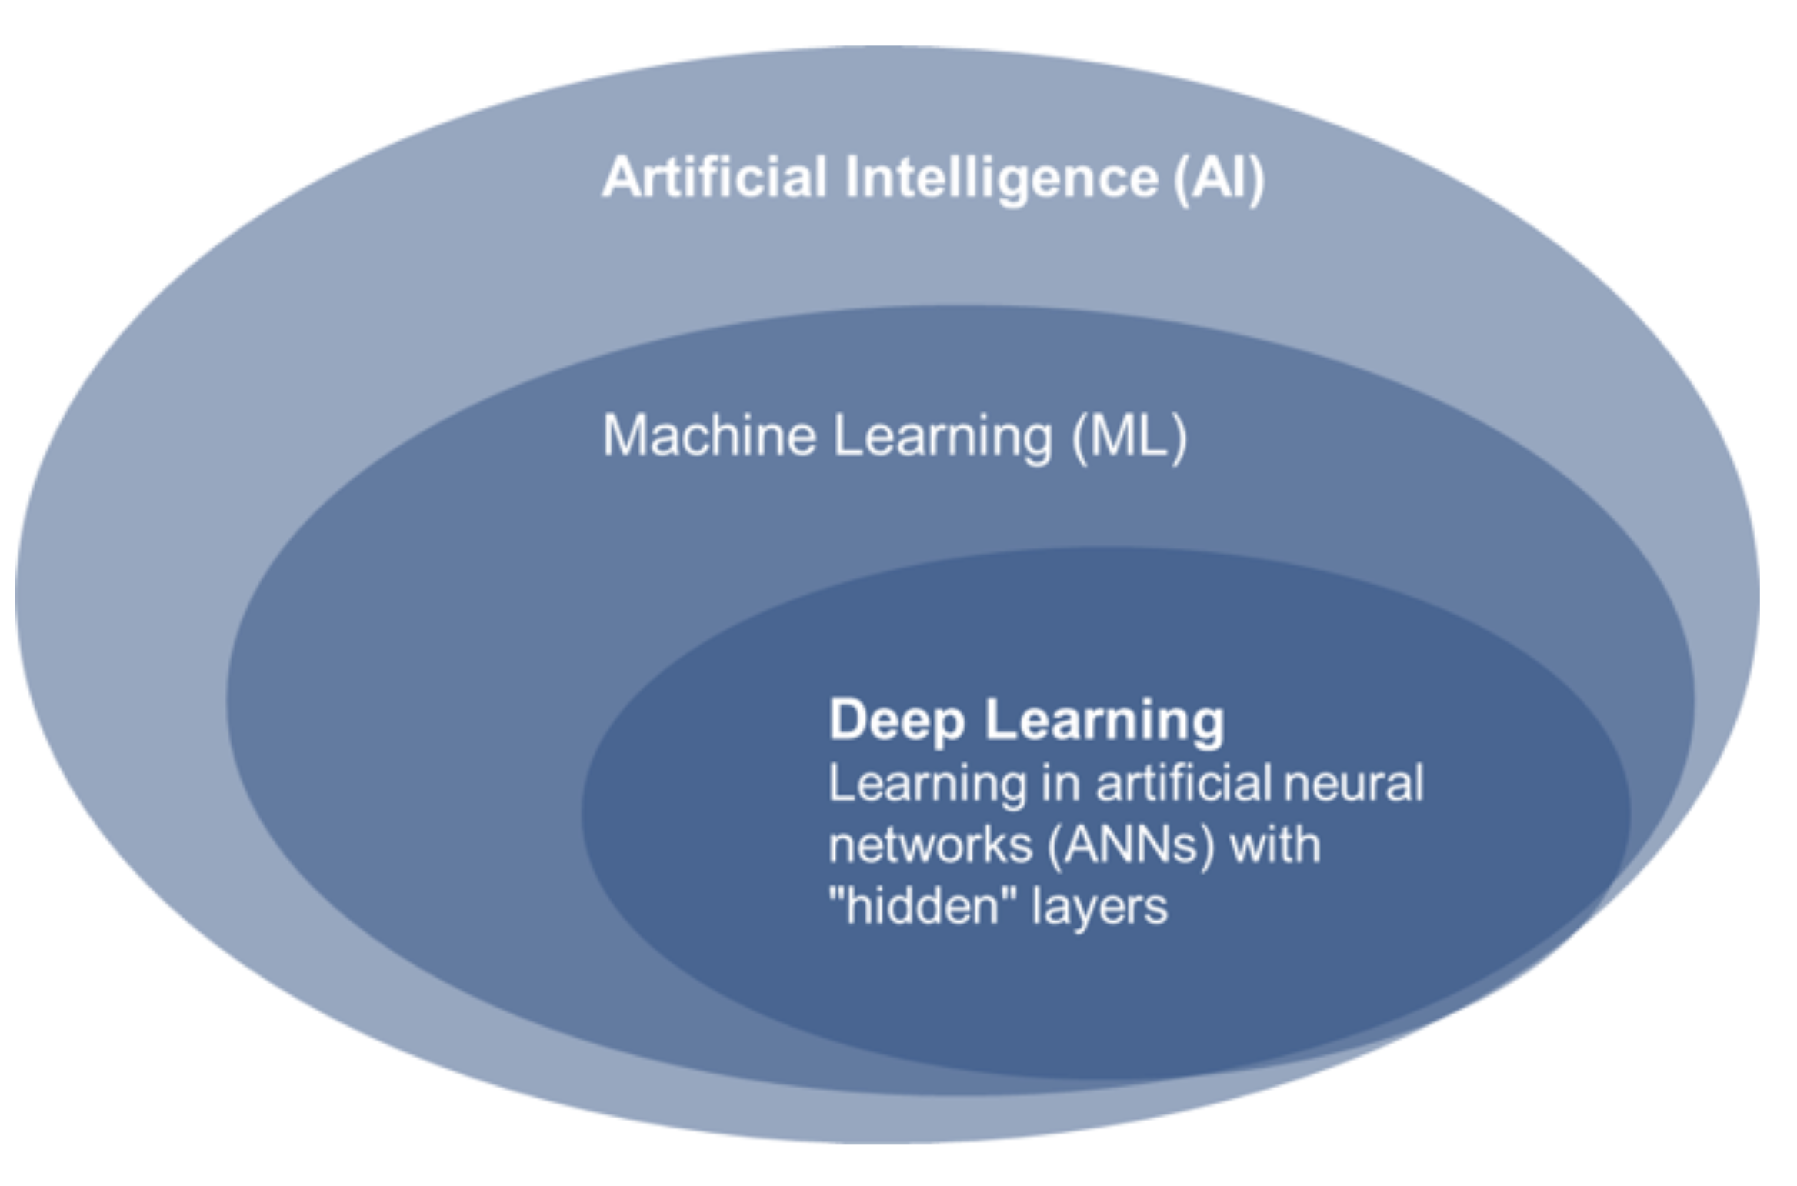
Computational science
Data Science
Machine Learning
Artificial Intelligence

Slide 9
Computational science `producing governing equations’ e.g. tumor growth
Data Science `producing insights’ e.g. explorative and longitudinal data analysis
Machine Learning `producing predictions’ e.g. biomarkers treatment response
Artificial Intelligence `producing actions’ e.g. imaging-guided robot surgery

Slide 10

DEEP LEARNING MODELS
... engineered systems inspired by the biological brain

Slide 11
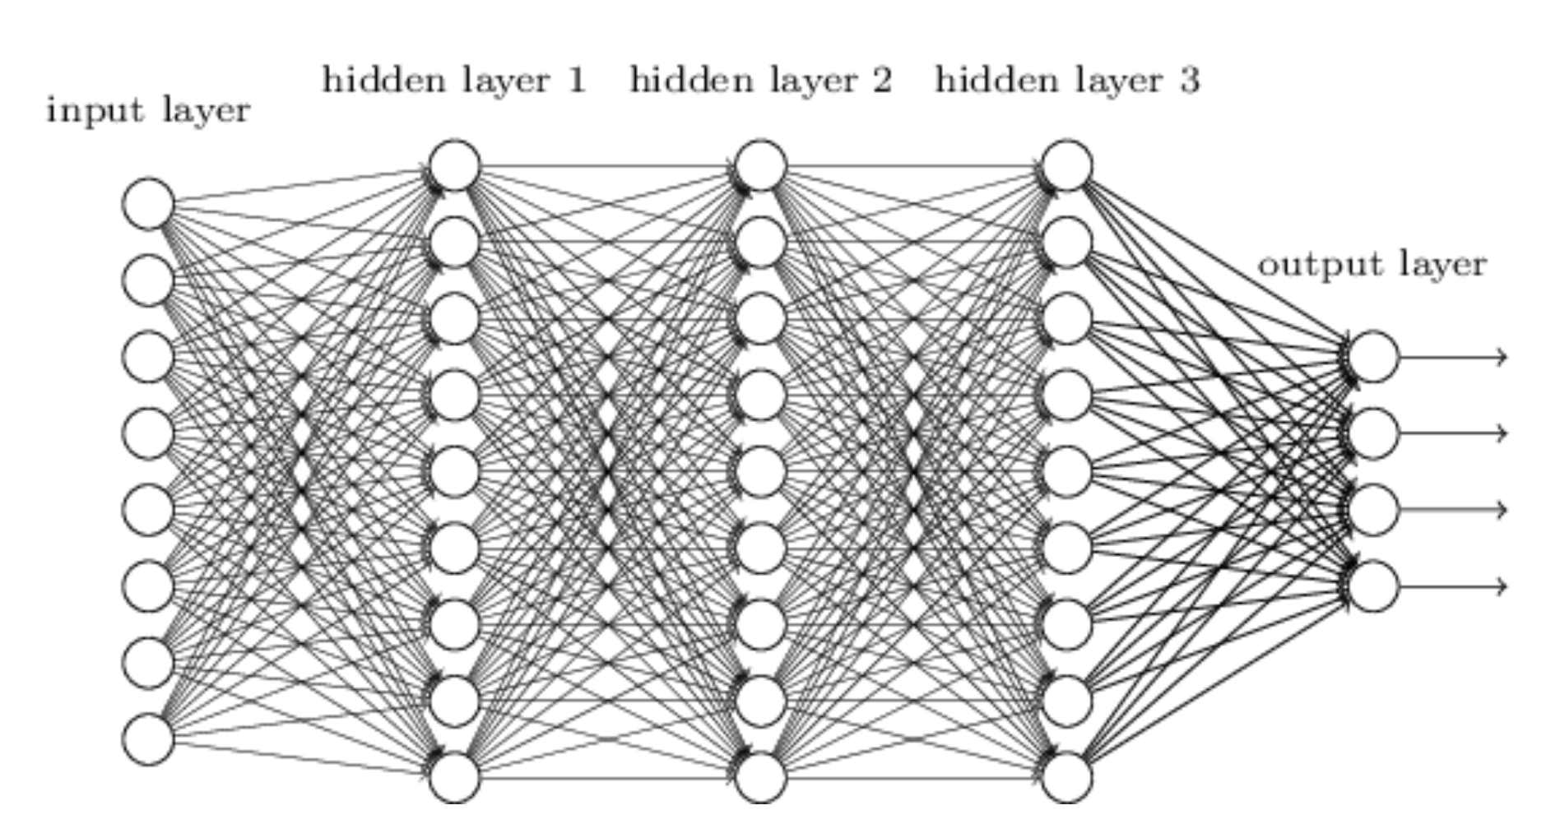



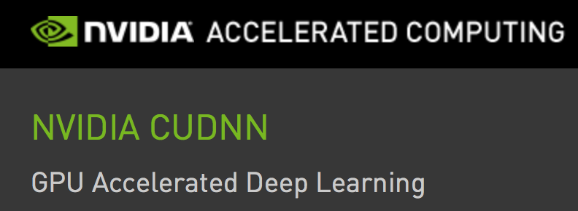
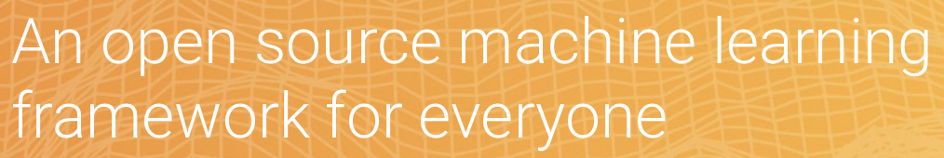
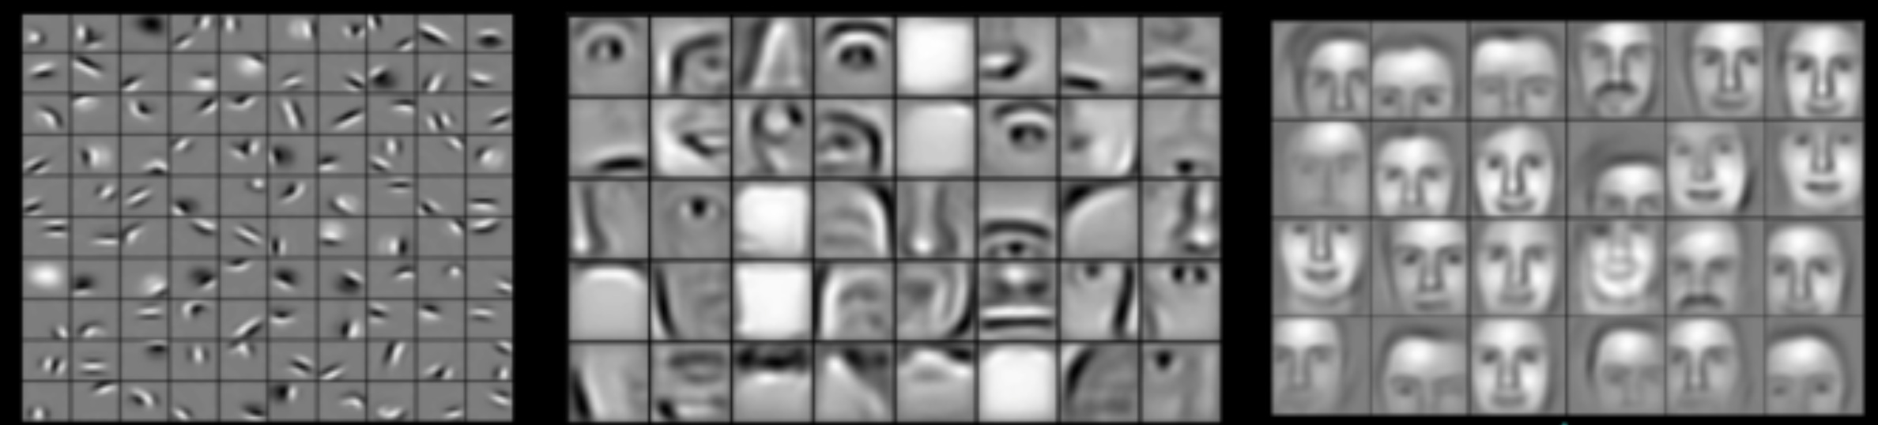

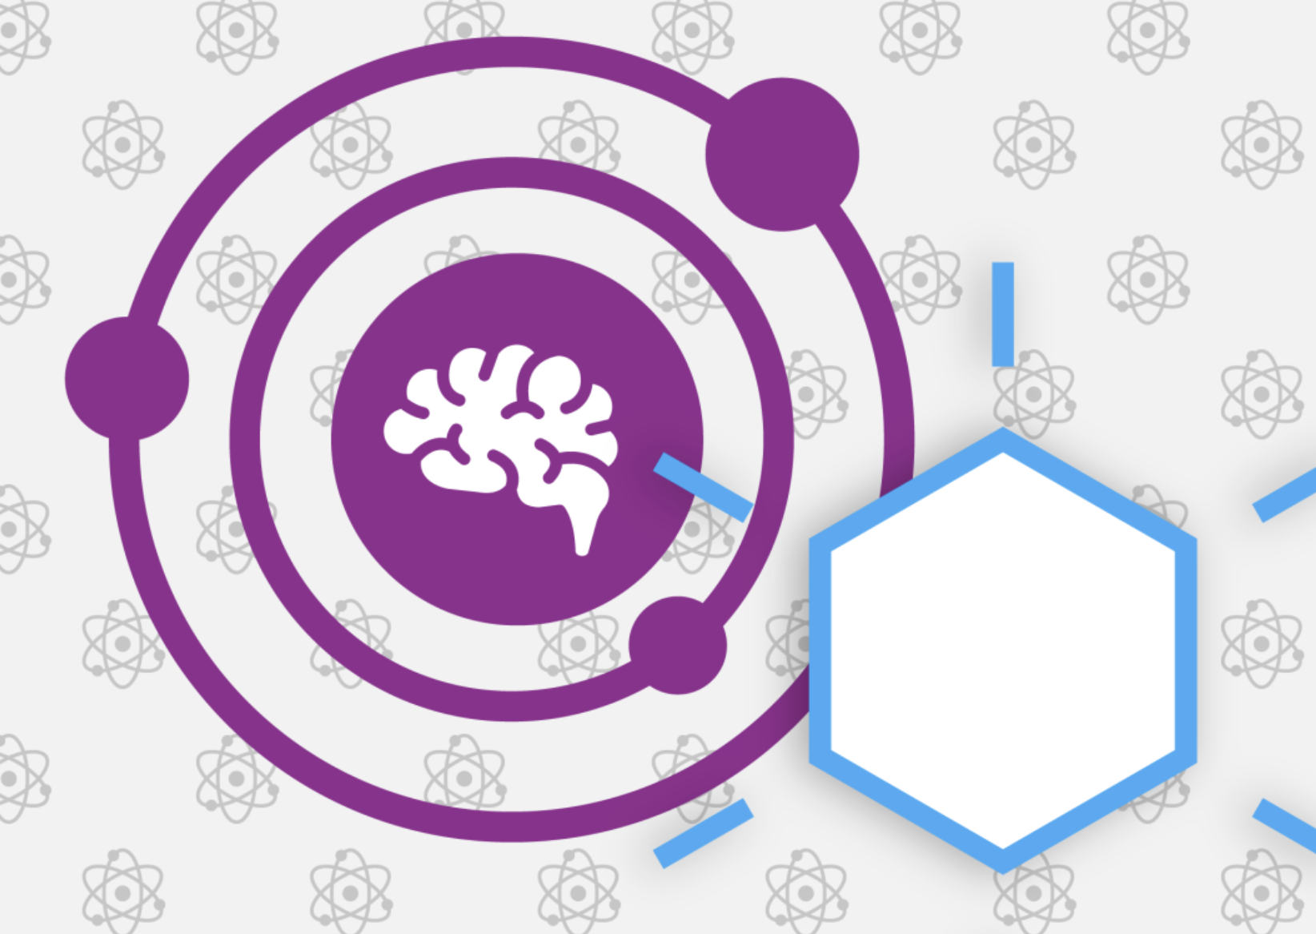

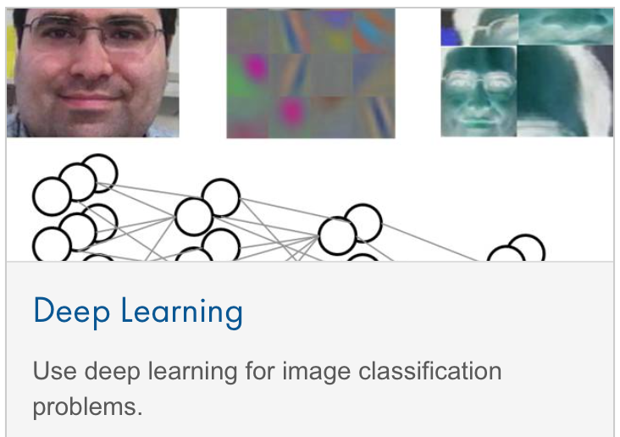

Neural networks - deep learning
Deep learning is a branch of machine learning based on a set of algorithms that attempt to model high-level abstractions in data by using multiple processing layers, with complex structures or otherwise, composed of multiple non-linear transformations
Input layer
Hidden layer 1
Hidden layer 2
Hidden layer 3
Output layer
Wikipedia
l a y e r s o f f e a t u r e s

Slide 12

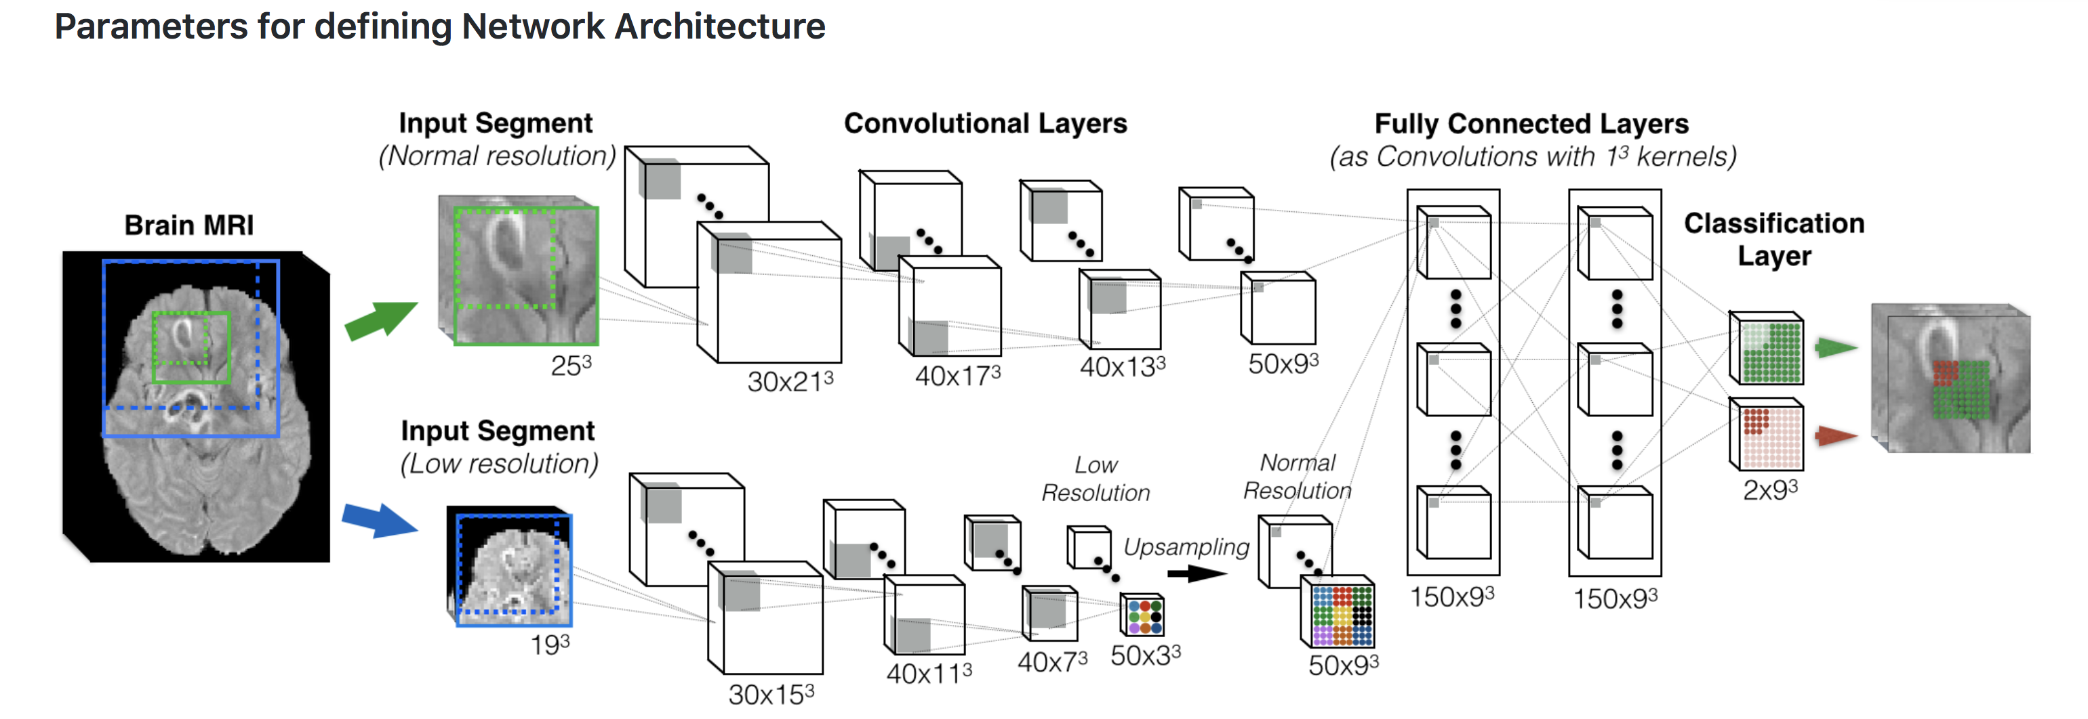
By training thousands of connections (“synaptic weights”) the multilayer
deep neural network will learn brain anatomy at many spatial scales
A double-pathway architecture for multi-scale processing
Lesion
segmentation
At each layer, the number and size of feature maps (FMs) is depicted in the format (Number-Of-FMs x Dimensions).
https://github.com/Kamnitsask/deepmedic

Slide 13
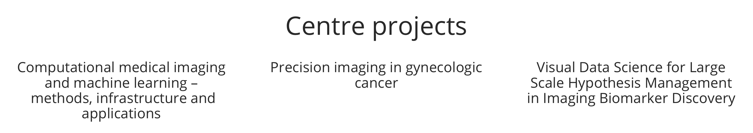
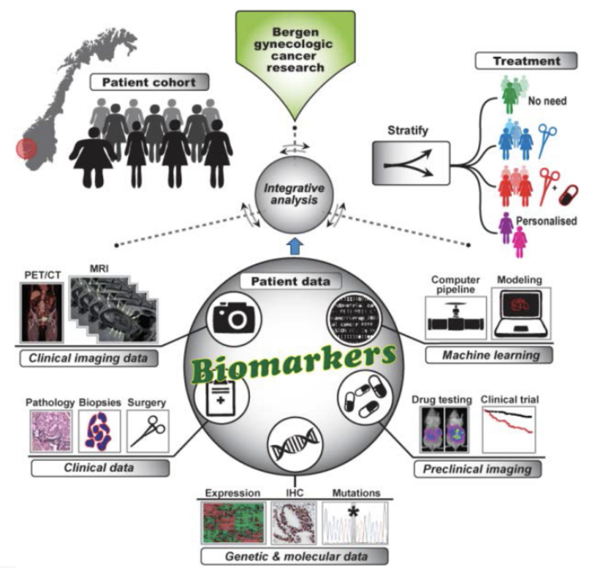
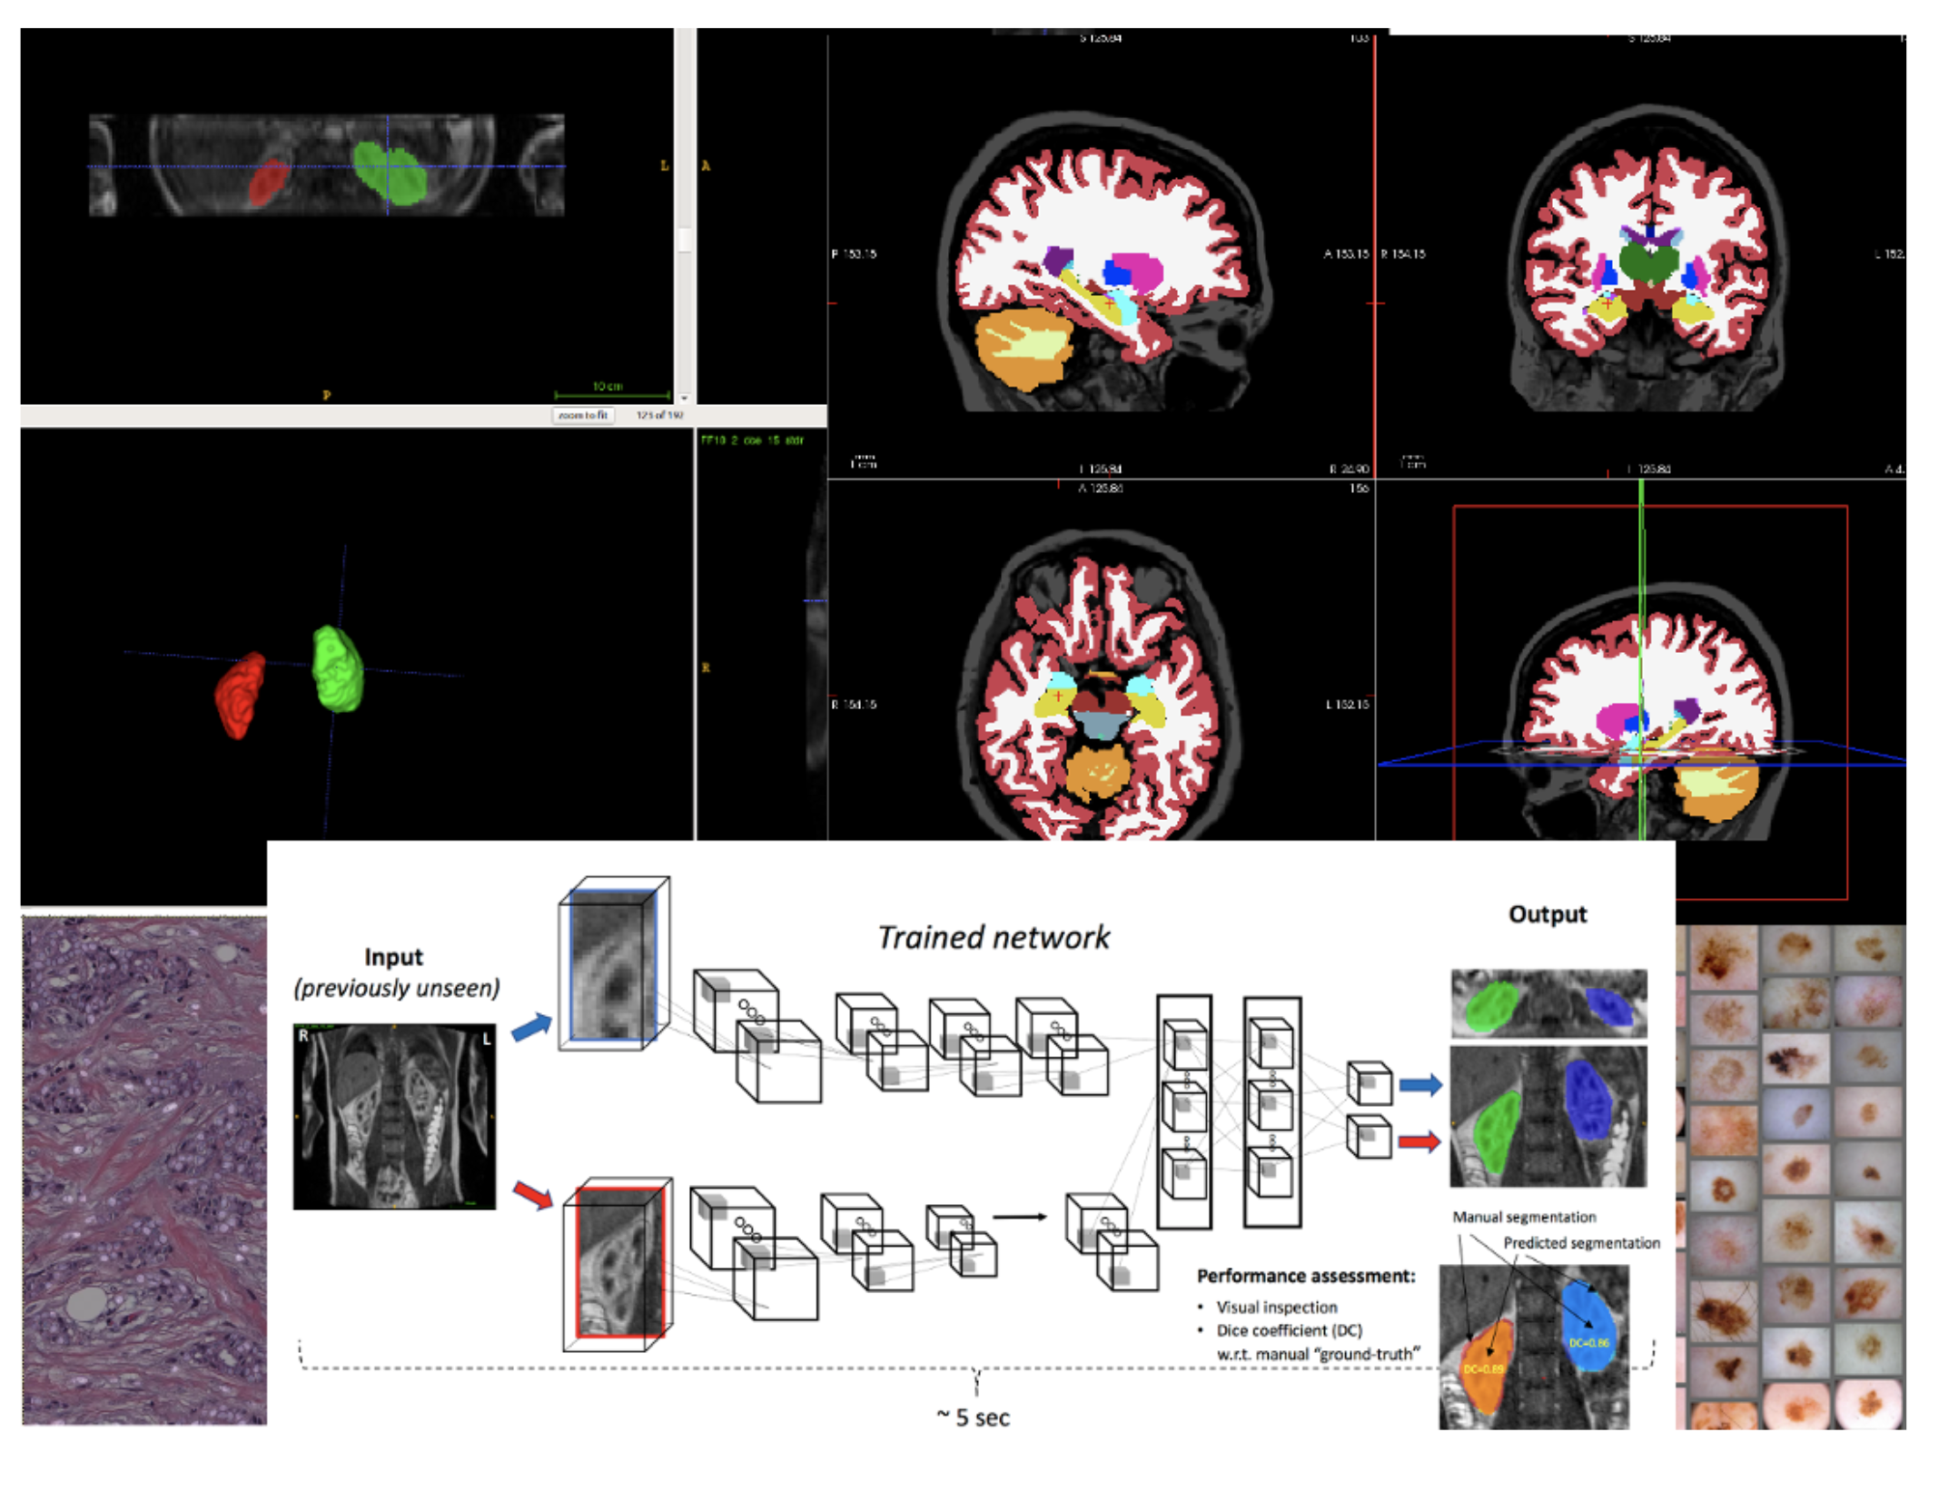
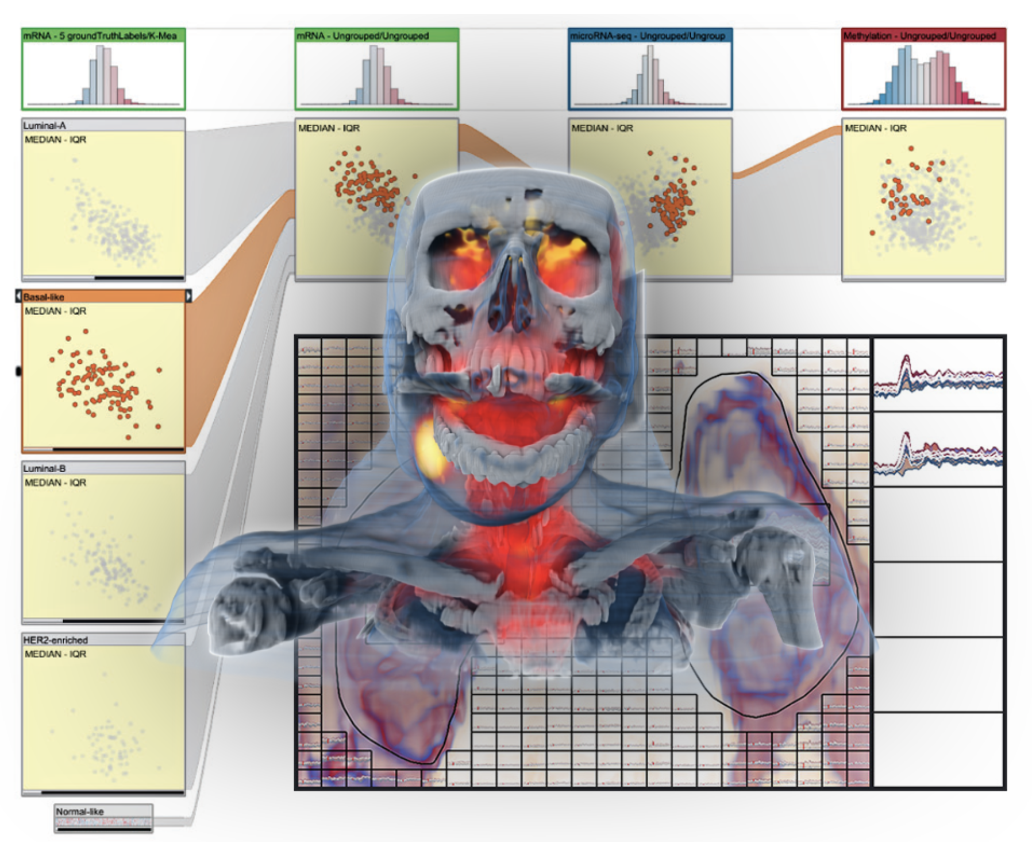
The Mohn Medical Imaging and Visualization Centre
Computational medical imaging and machine learning – methods, infrastructure and applications
– A collaboration between the Department of Biomedicine, UiB, and the Department of Computing, Mathematics and Physics, HVL
https://mmiv.no/machinelearning

Slide 14
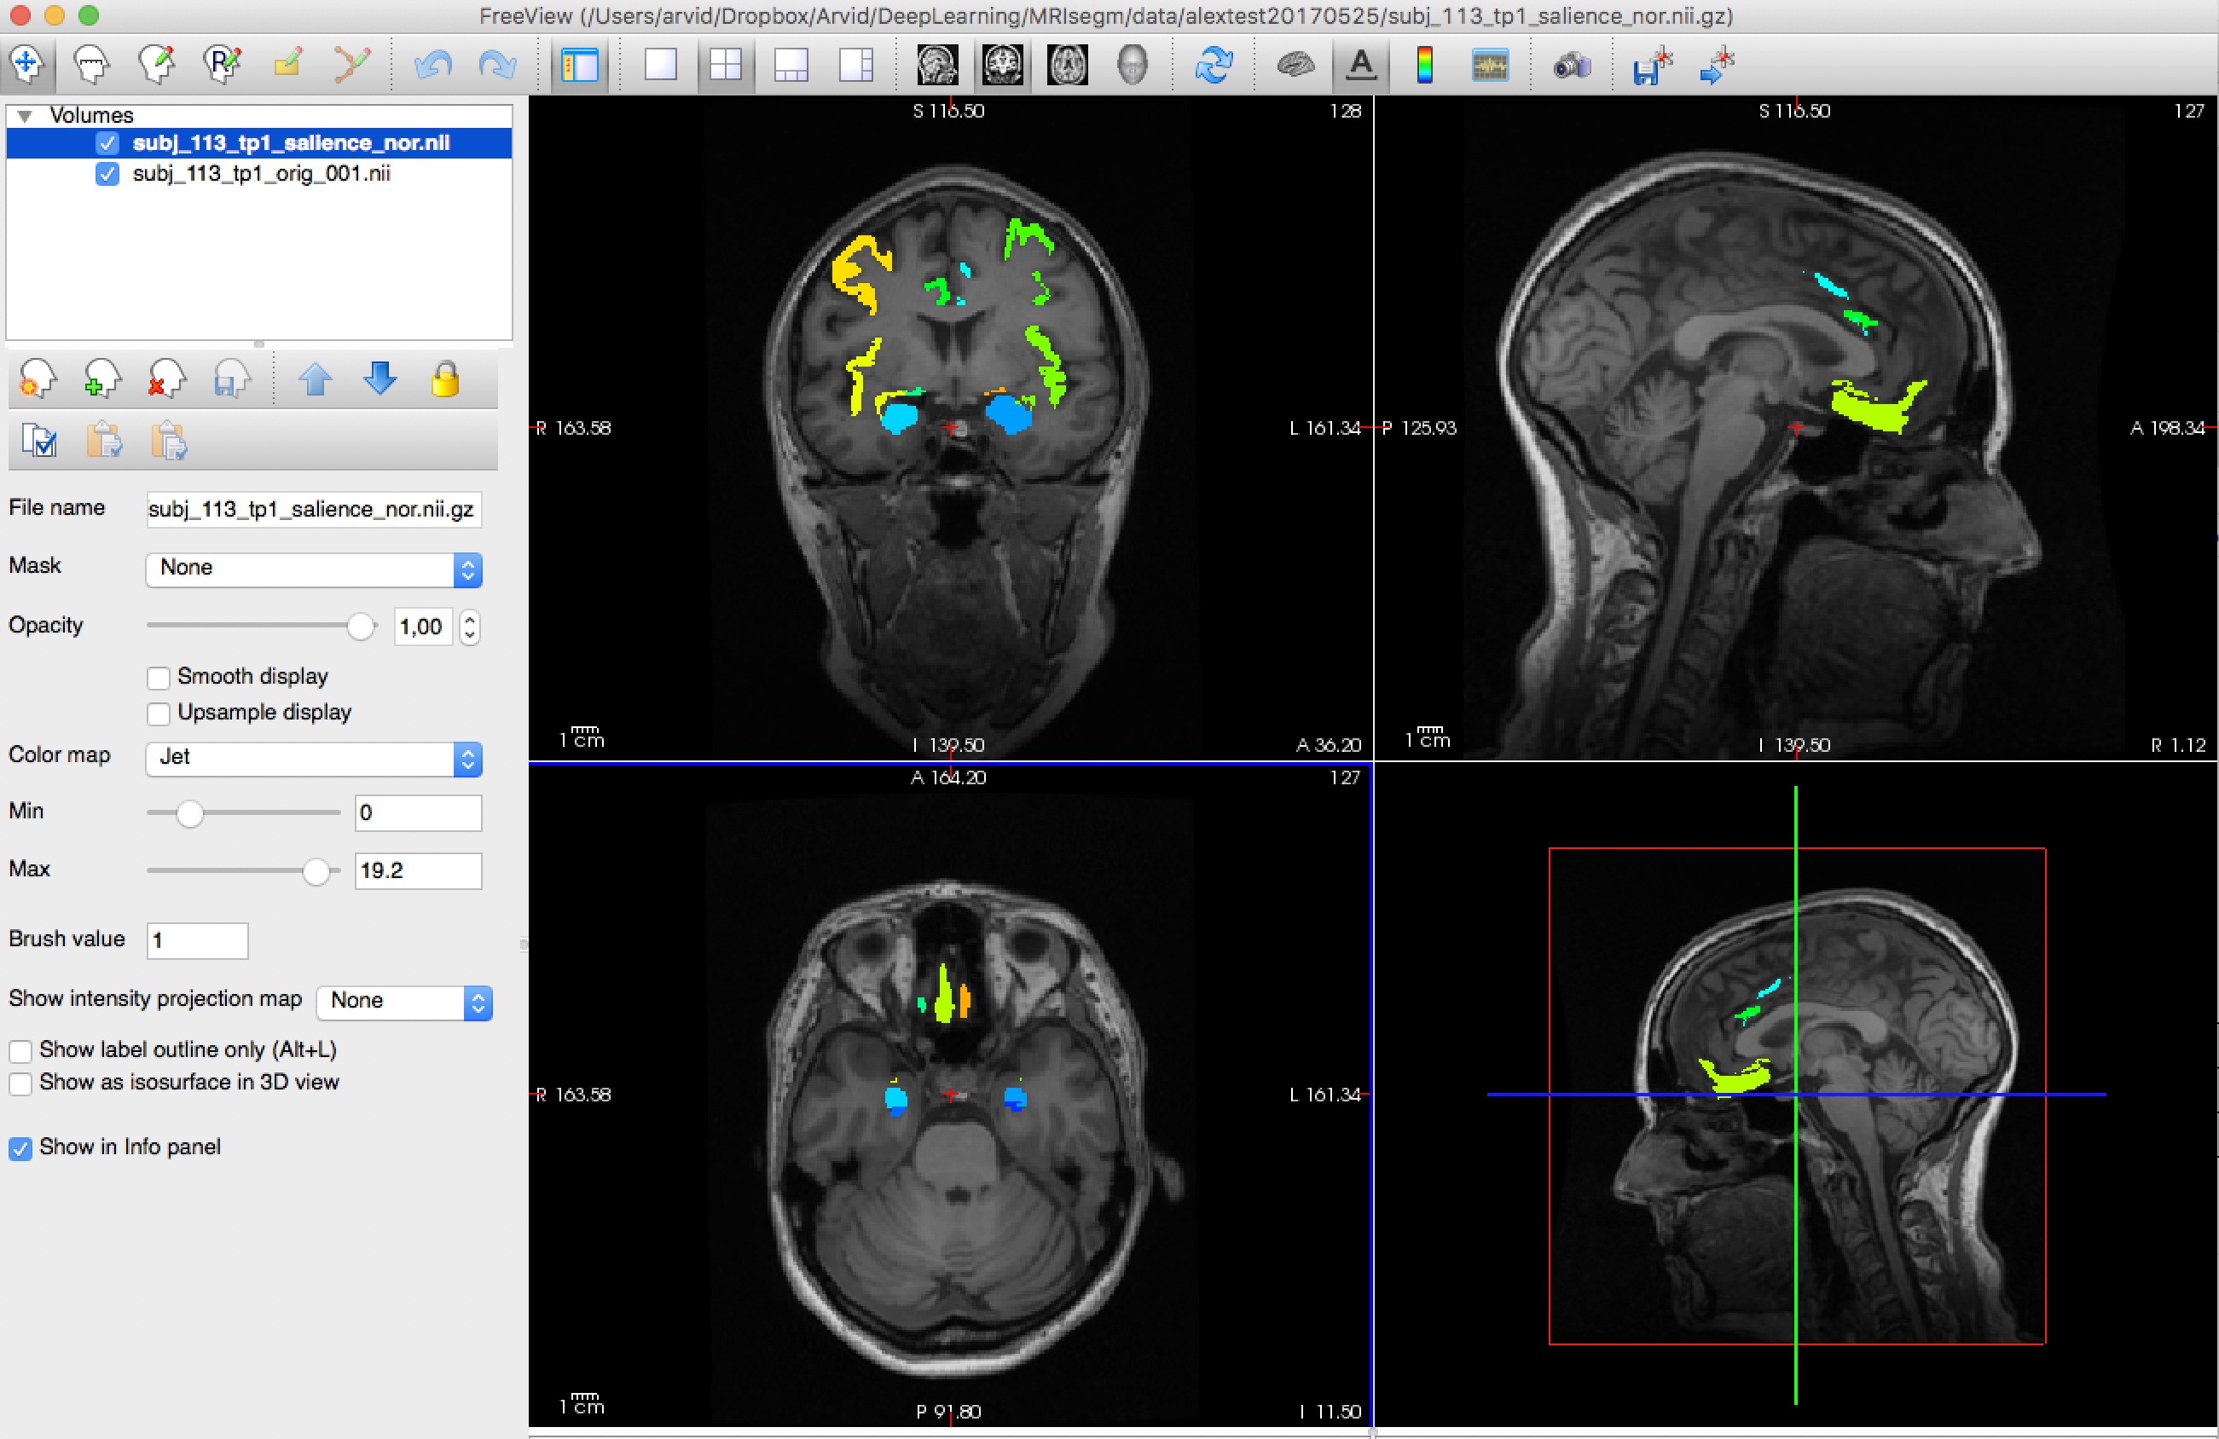
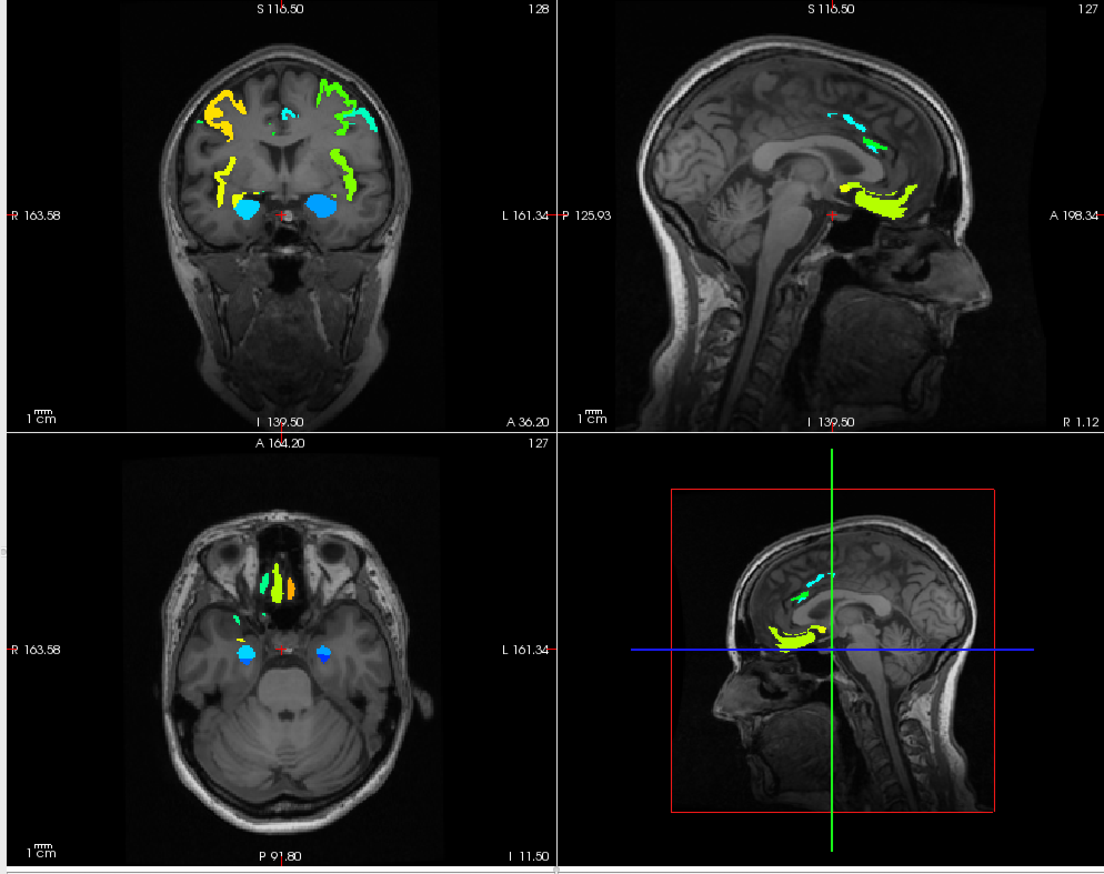
Training the CNN takes many hours to several days, dependent on number of training sets, networks architecture and hardware (GPUs)
Freesurfer 6.0 ( “ground truth” )
Deep learning (CNN)
~10 hr processing time
~1 min classification time !

Slide 15
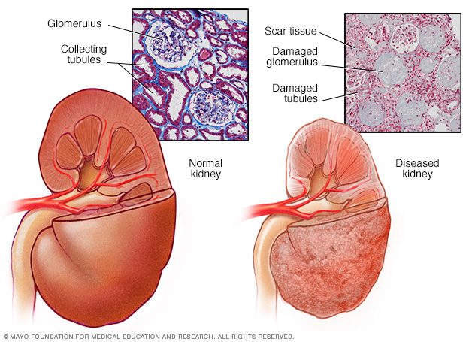
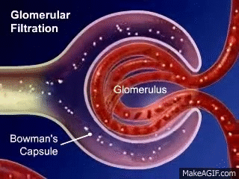
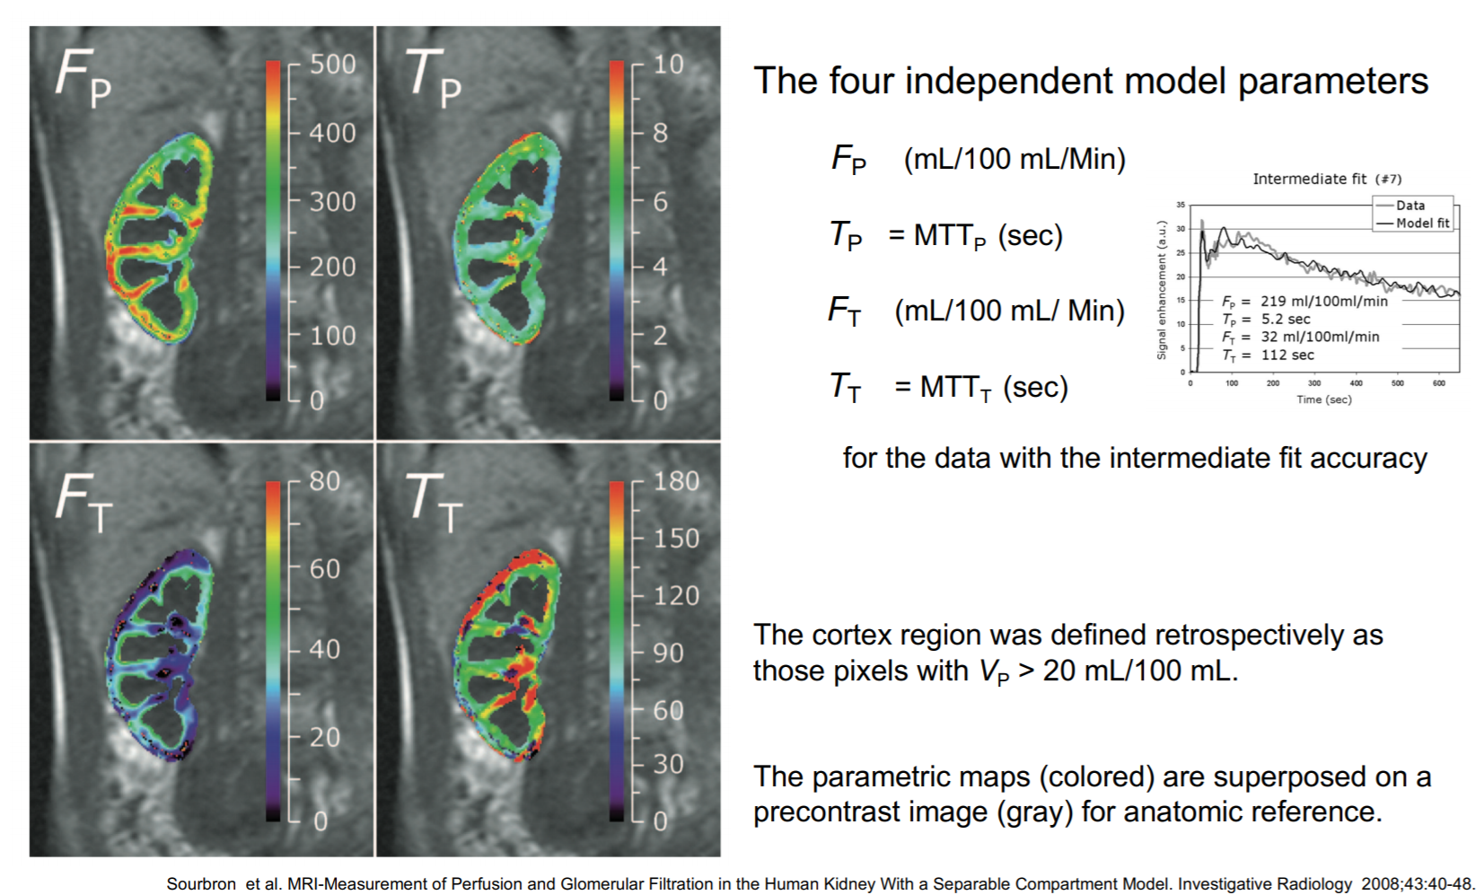
Chronic kidney disease ↑
Diabetes, hypertension, …
https://www.mayoclinic.org
Functional renal imaging
DCE-MRI
Non-invasive estimation of local
glomerular filtration rate (GFR)
… will need fast image
segmentation of the kidneys
Image-derived biomarkers

Slide 16
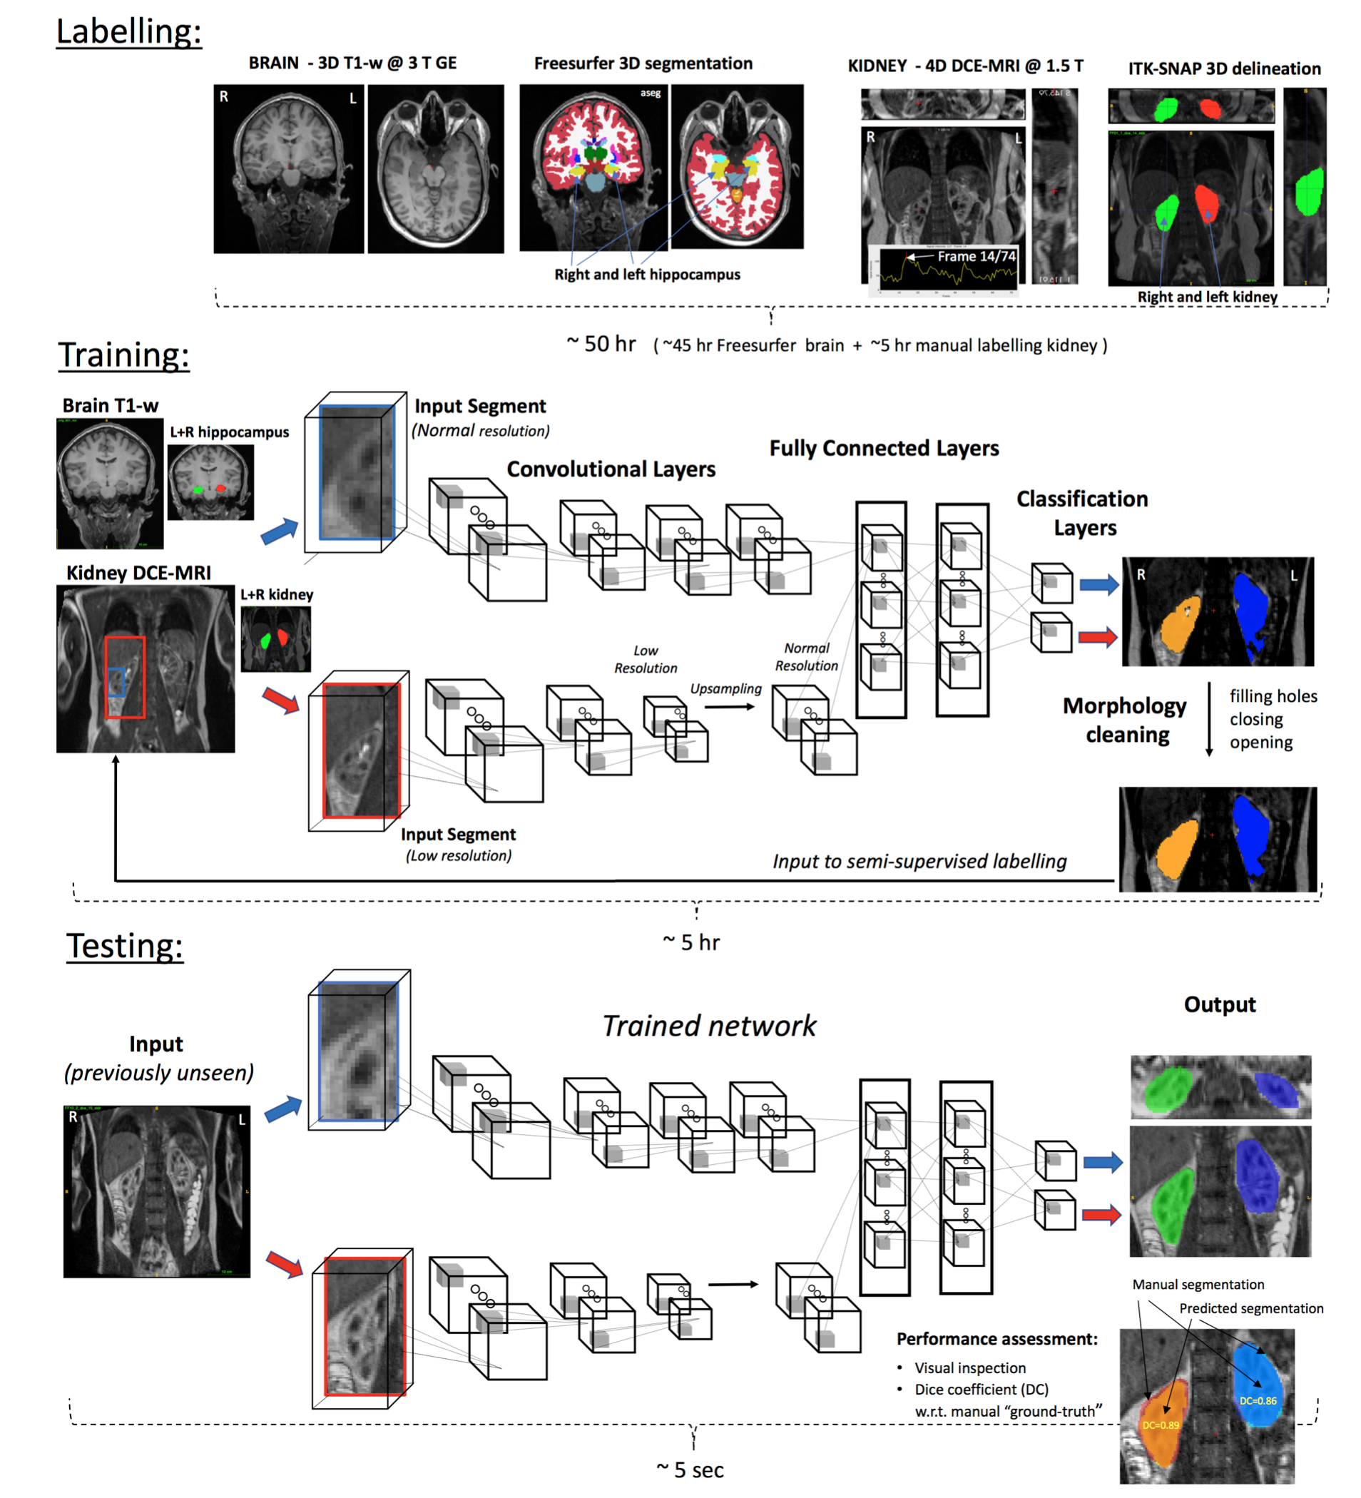
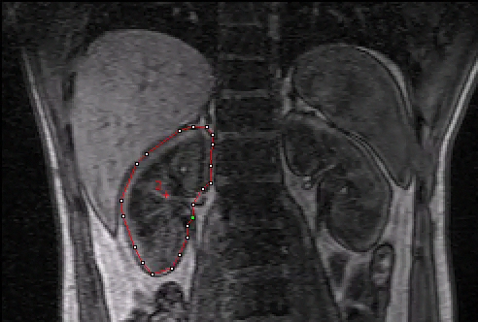
Fast semi-supervised segmentation of the kidneys in DCE-MRI using convolutional
neural networks (CNN) and transfer learning
Transfer learning
Alexander S. Lundervold et al.
~ 50 hr
Manual
3D labelling
(hippocampus)
A. S. Lundervold, J. Rørvik, A. Lundervold
Functional Renal Imaging: Where Physiology, Nephrology, Radiology and Physics Meet, Berlin 2017
~ 5 hr
~ 5 sec

Slide 17
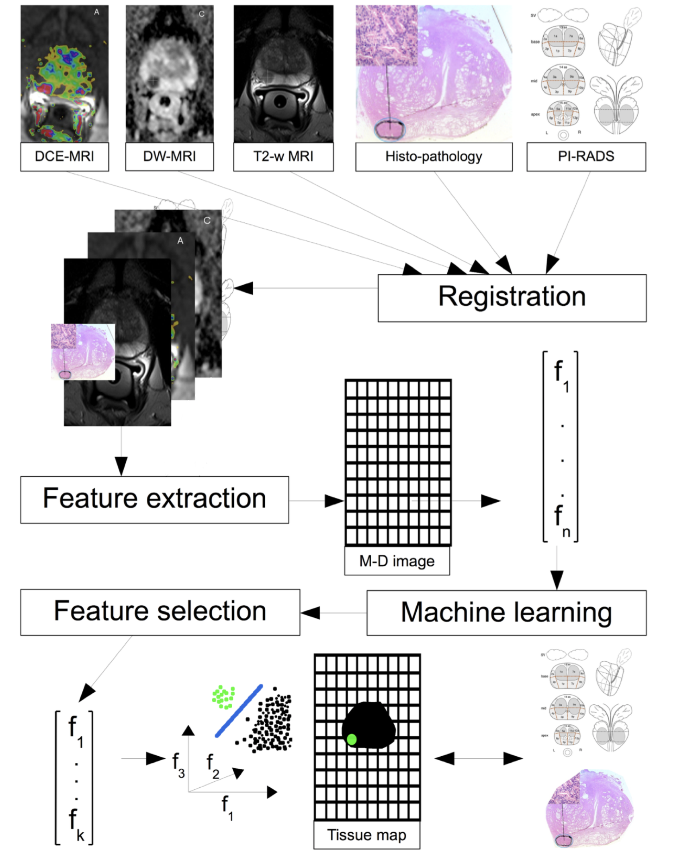
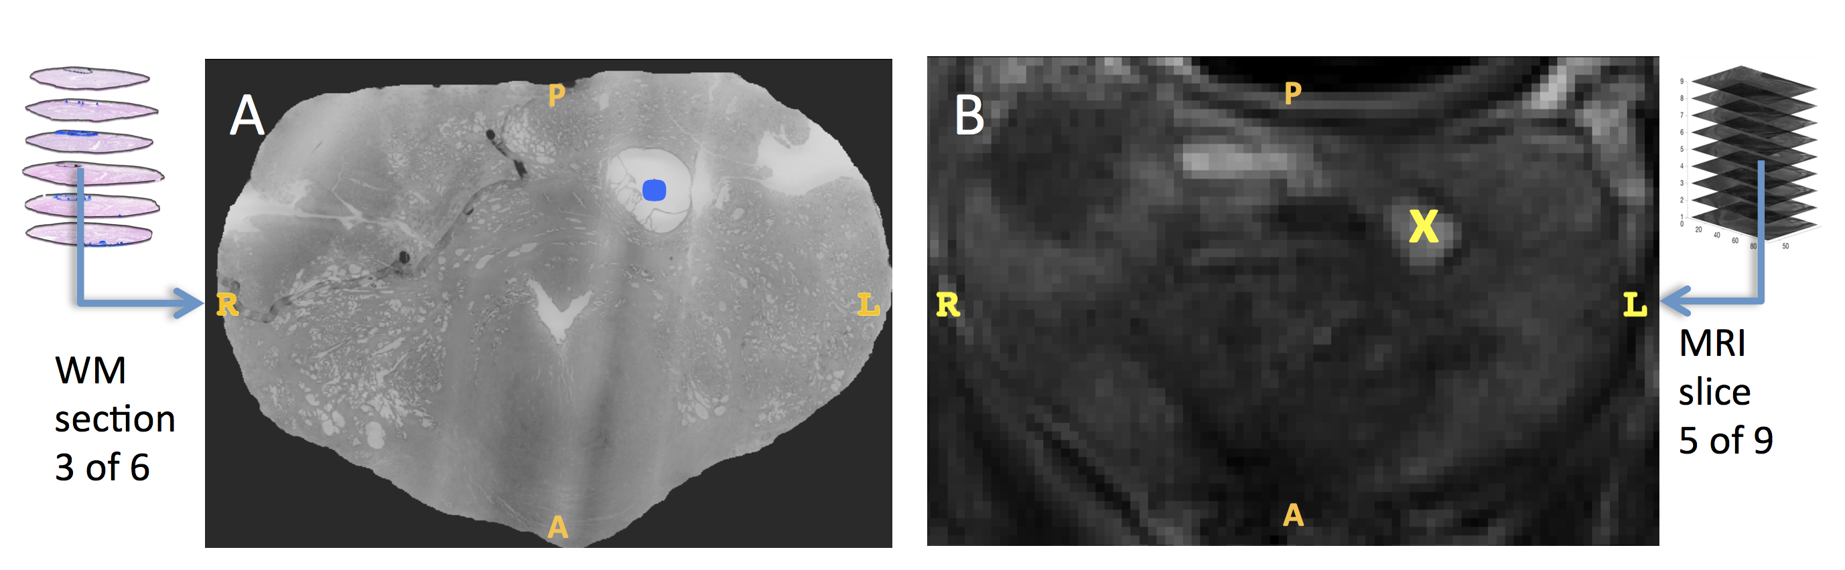
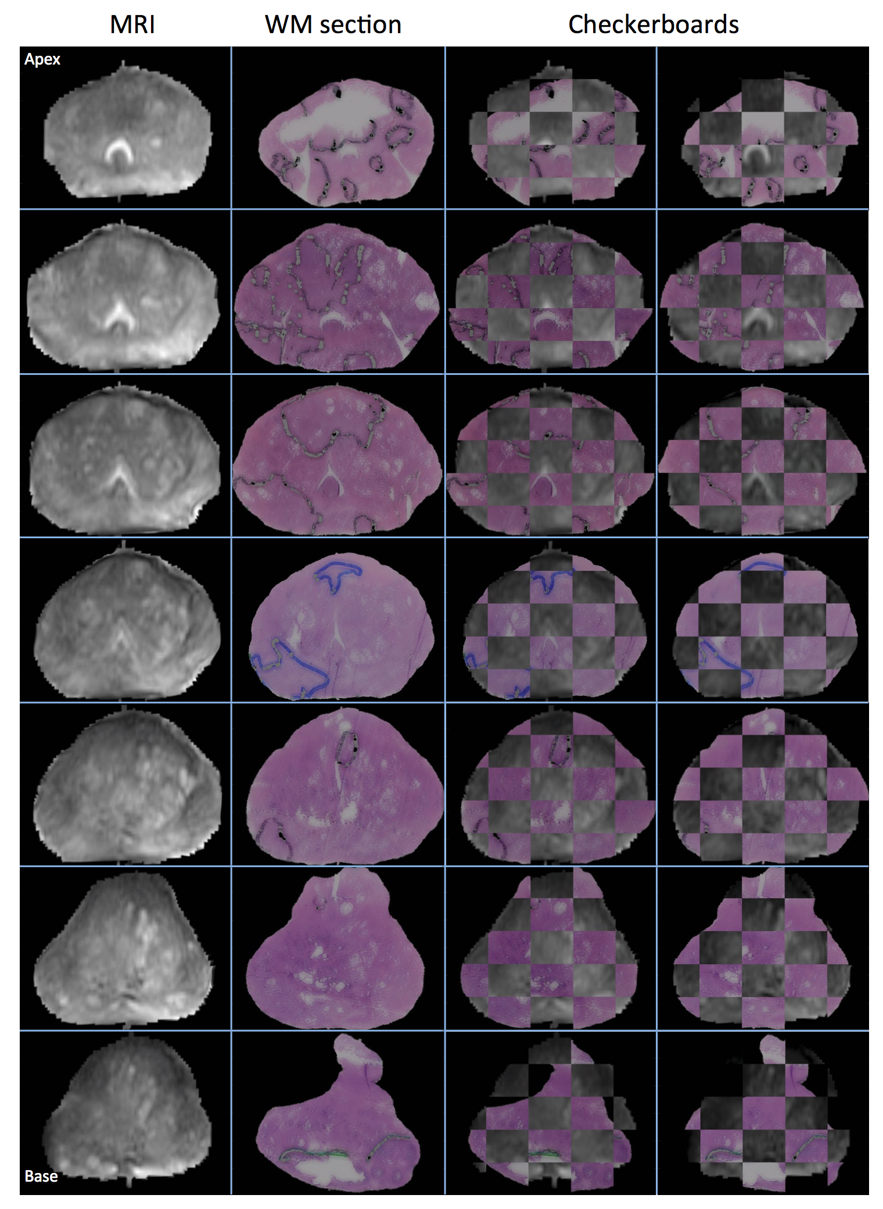
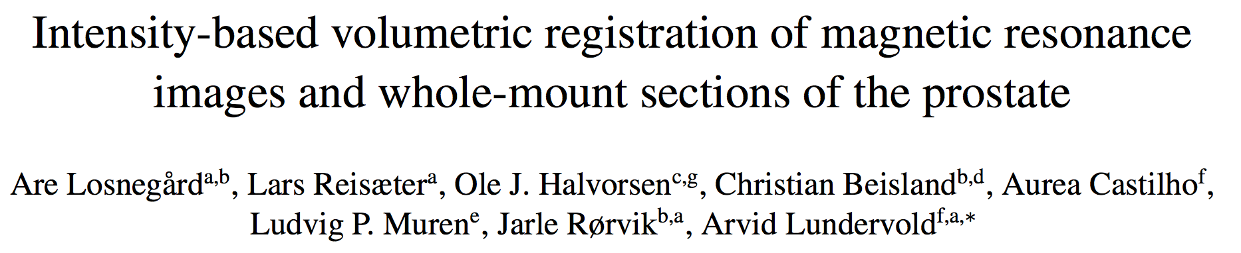
Prostate cancer
Multi-parametric MRI and histopathology
From digital pathology to
computational pathology
Multi-channel
image
Histology MRI
Computerized Medical Imaging and Graphics 63 (2018) 24–30
Are Losnegård et al.

Slide 18
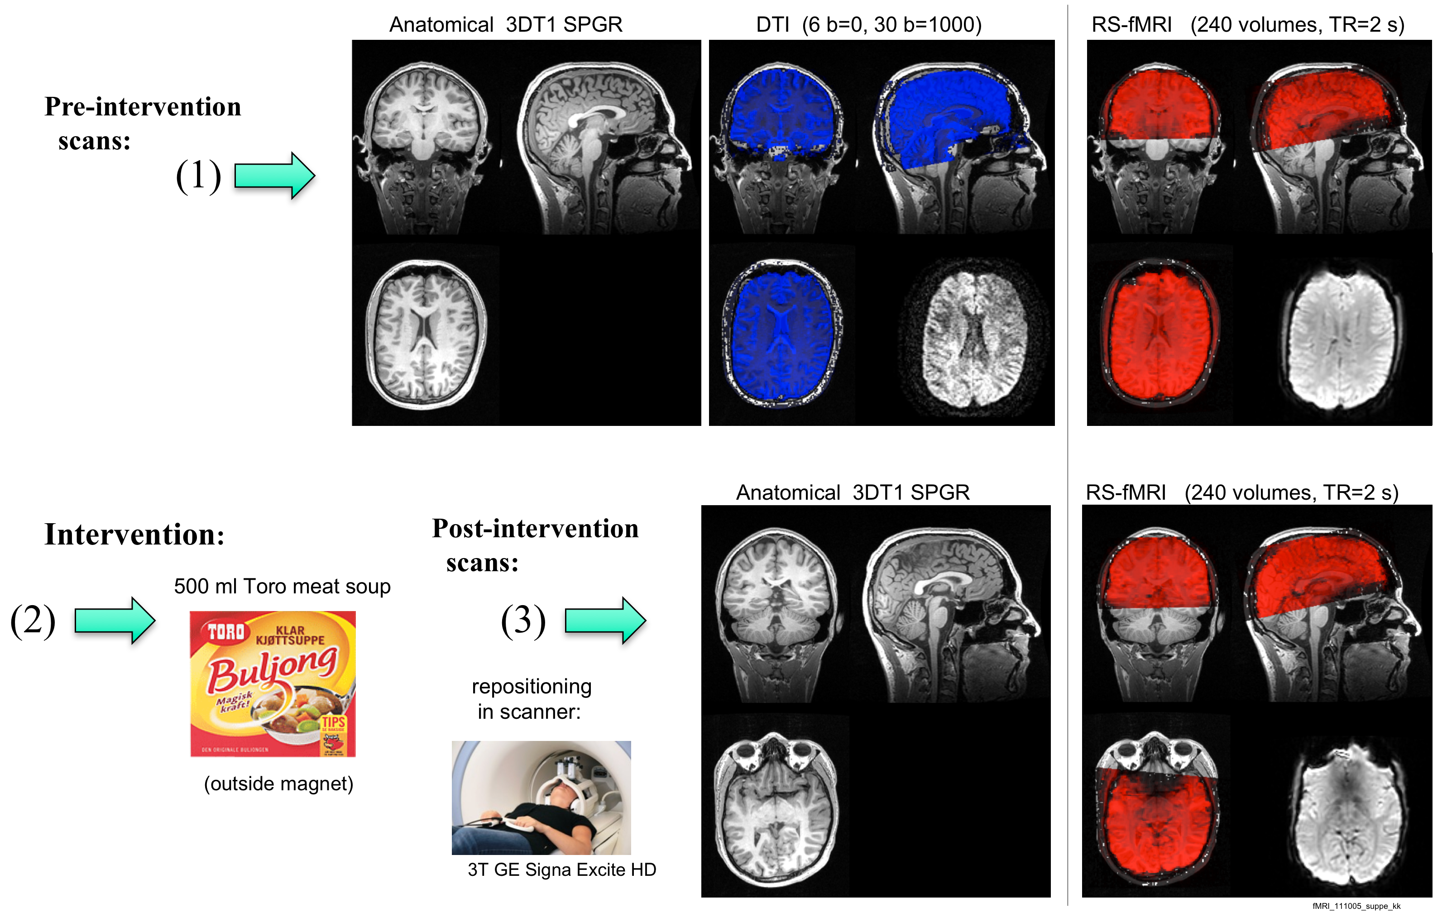
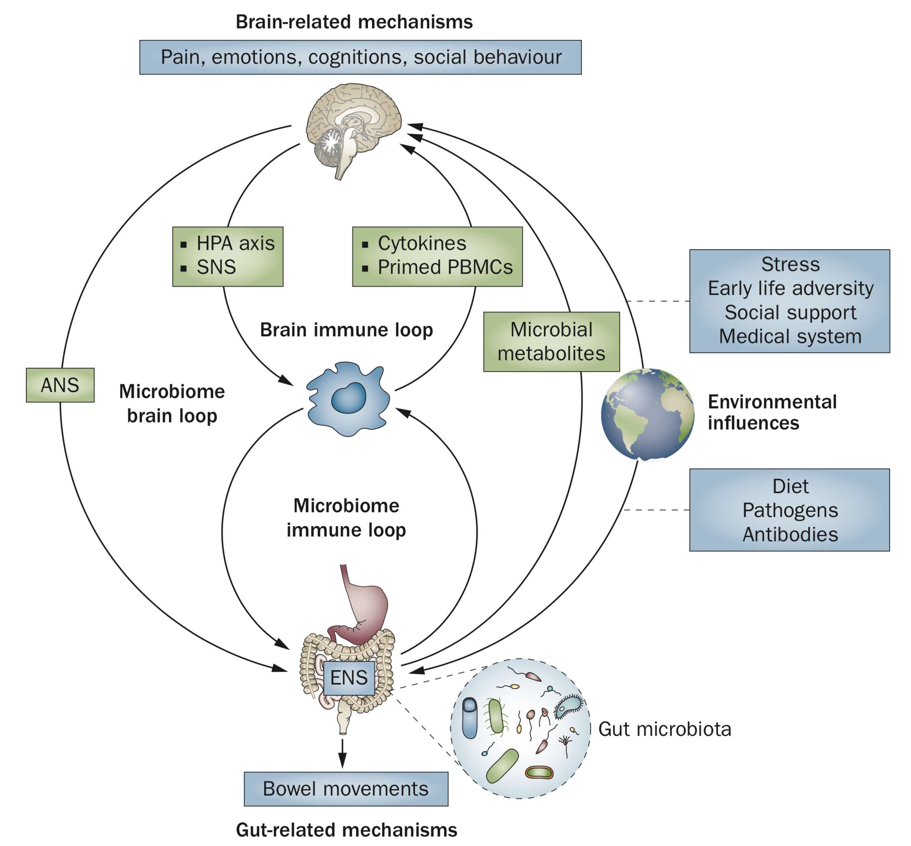
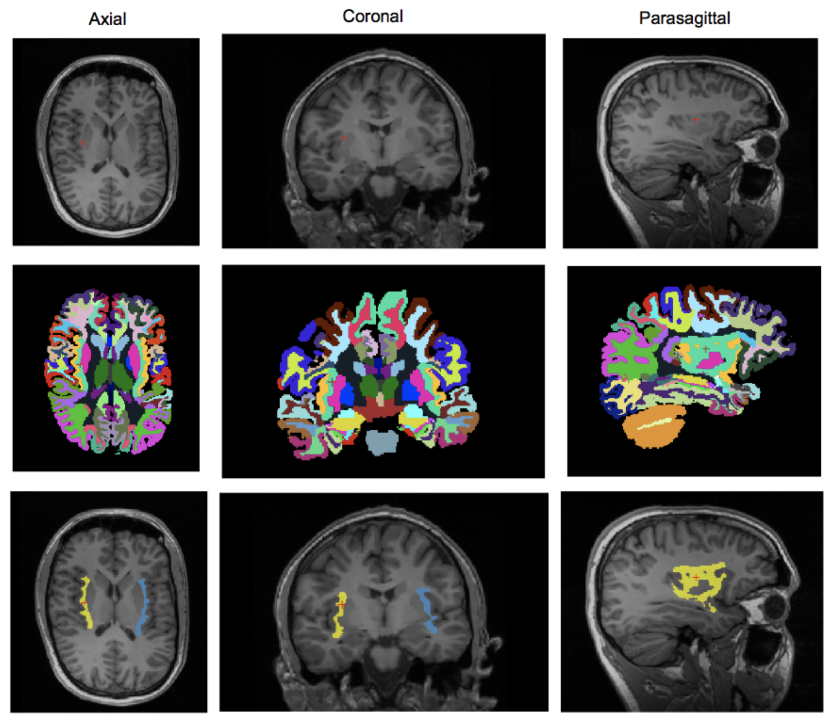
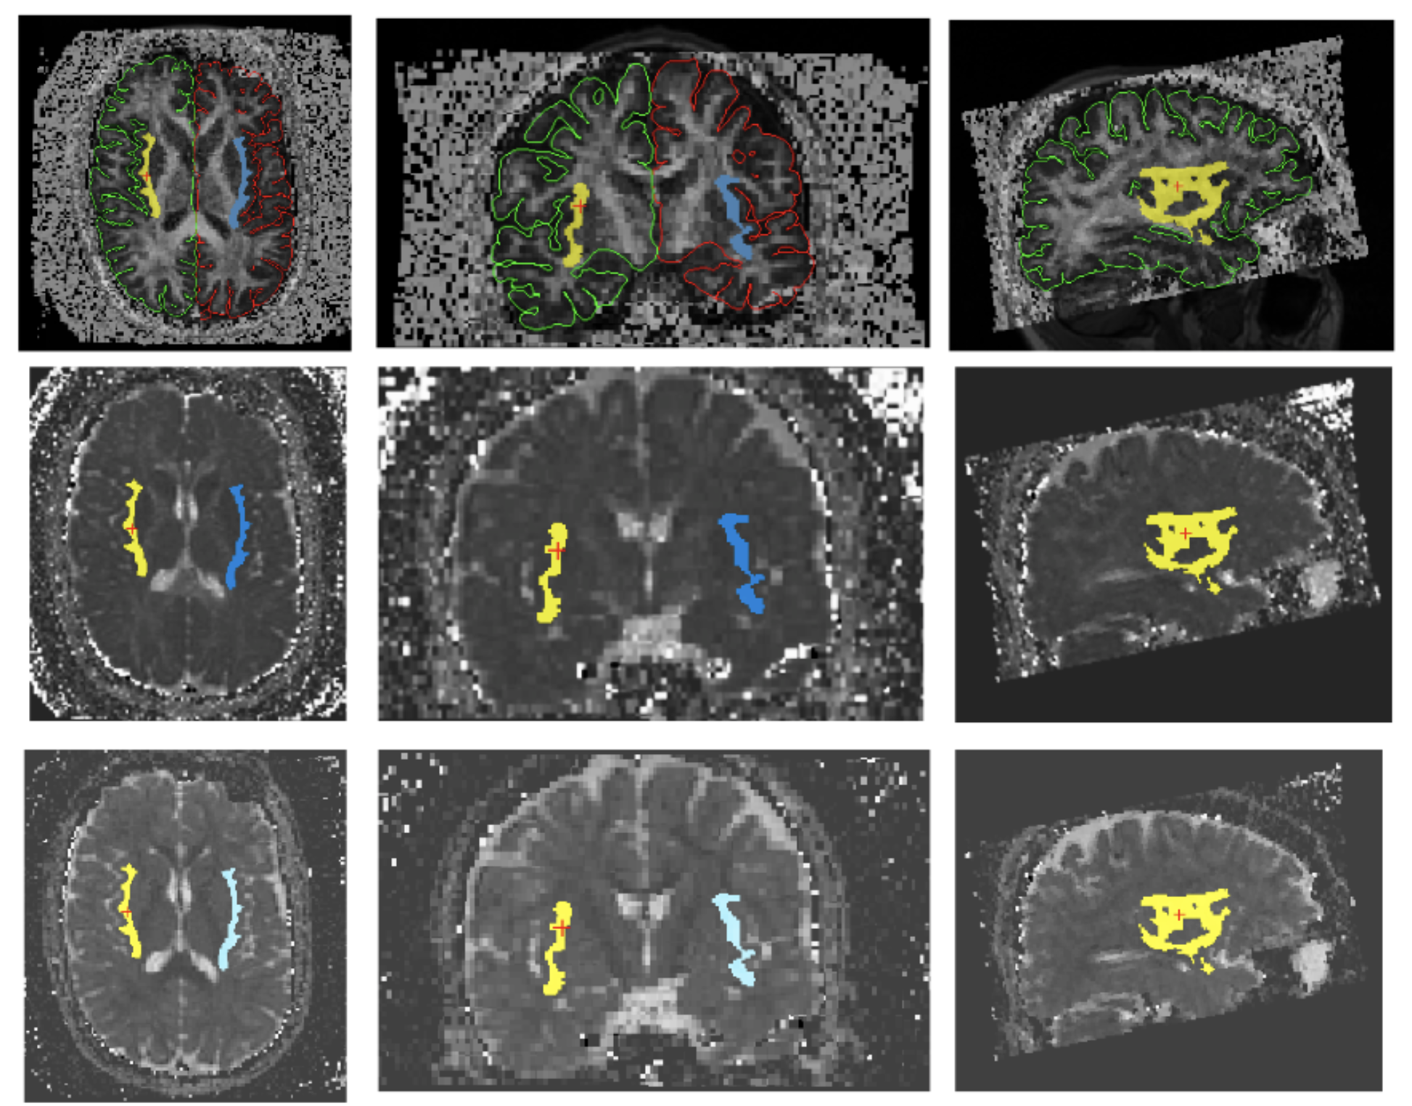
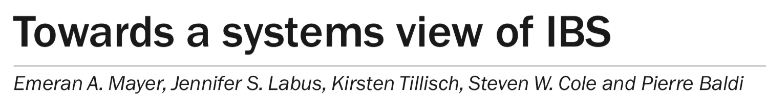
Neuro-gastroenterology
Brain-gut axis and prediction of IBS from sMRI, dMRI, and resting-state fMRI
aMRI dMRI fMRI
E. Valestrand
T. Hausken
A. Lundervold
FA map
Freesurfer 6
segmentation
AD map
Insula /
salience
network
Nat. Rev. Gastroenterol. Hepatol.12, 592–605 (2015)
RD map

Slide 19
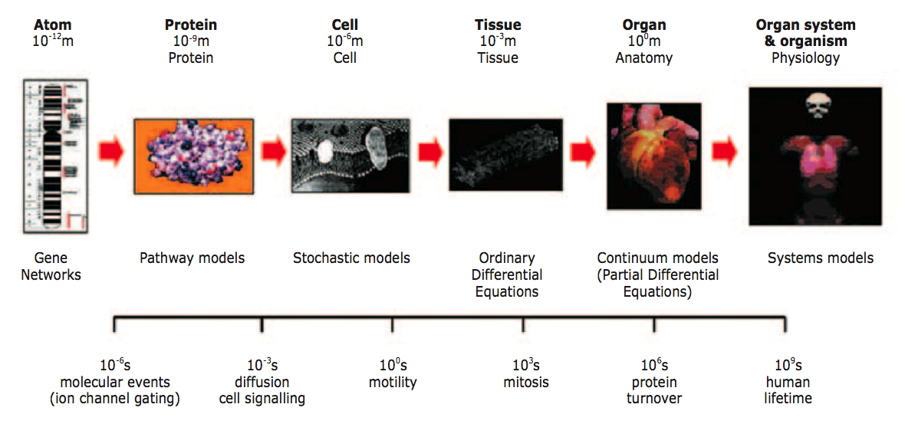
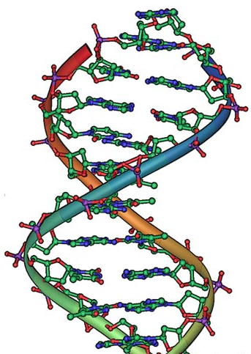
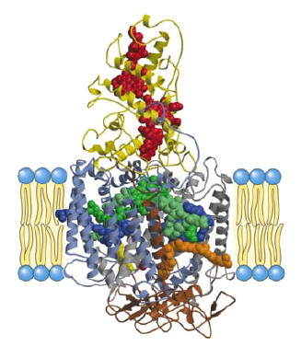
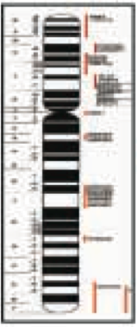
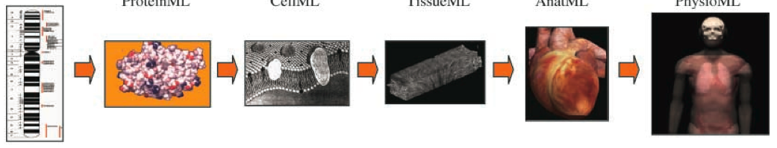
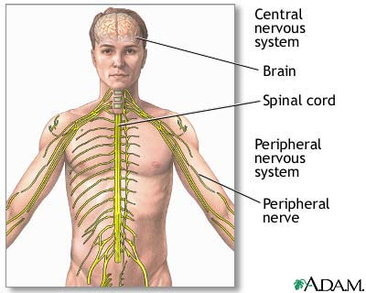
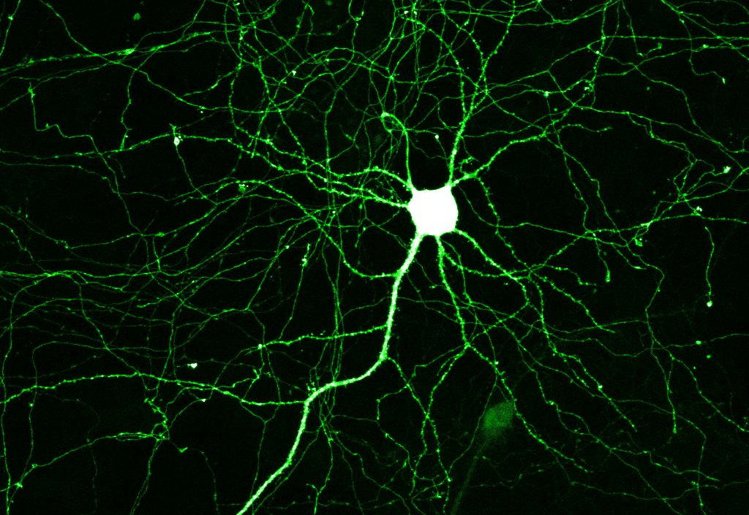
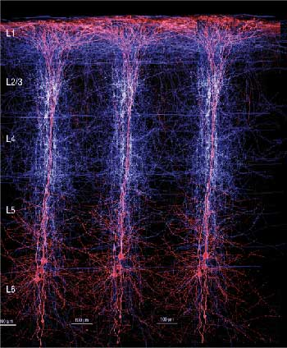
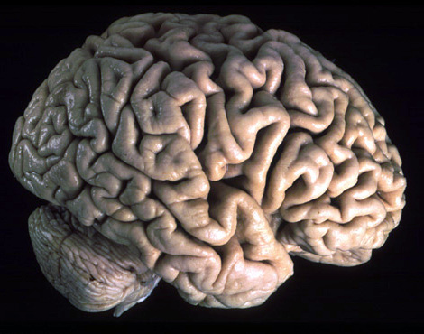
The future of (bio)medical imaging and precision medicine …
MULTIMODAL IMAGING + OMICS + SYSTEMS BIOLOGY / SYSTEMS MEDICINE
TRANSDISCIPLINARITY and COMPUTATIONAL APPROACHES [ML] to the assess and predict
the multi-scale nature of molecules (-omics), cells, tissues and organs in health and disease
Challenges:
Atom
10⁻¹² m
Protein
10⁻⁹ m
Cell
10⁻⁶ m
Tissue
10⁻³ m
Organ
10⁰ m
Anatomy
Organ system
& organism
Physiology
Δ mindset
Δ skillset
Δ toolset
SPACE:
Brain
Spinal
cord
Peri-
pheral
nerves
- open science
- reproducible
research
- education
- training
Gene
networks
Pathway models
Stochastic models
Ordinary
Differential
Equations
Continuum models
(Partial Differential
Equations)
Systems models
TIME:
10⁻⁶ s
molecular events
(ion channel gating)
10⁻³ s
diffusion
cell signalling
10⁰ s
motility
10³ s
mitosis
10⁶ s
protein
turnover
10⁹ s
human
lifetime
From: C. Dollery and R. Kitney, Systems biology: A vision for engineering and medicine, Tech. report, The Academy of Medical Sciences and The Royal Academy of Engineering, London, UK, Feb. 2007.

Slide 20
Thanks !
The challenge of imaging, precision and decision in society and in medicine

Slide 21
Computational medicine
A new field of science, which embraces mathematics, physics, information
technology, biomedical engineering, and medicine ...
... to collect, manage, mine, analyse and visualise a very heterogeneous mixture of datalike personalised genetic and proteomic profiles, bio-signals and the monitoring of movement, advanced imaging, and other relevant phenotype information in such a way that useful clinical information for improving human health can be extracted.”
– M. Daumer, SLCMSR / Munich&Cambridge International School for Clinical Bioinformatics and Technical Medicine
http://github.com/arvidl/computational-medicine

